Slide 1

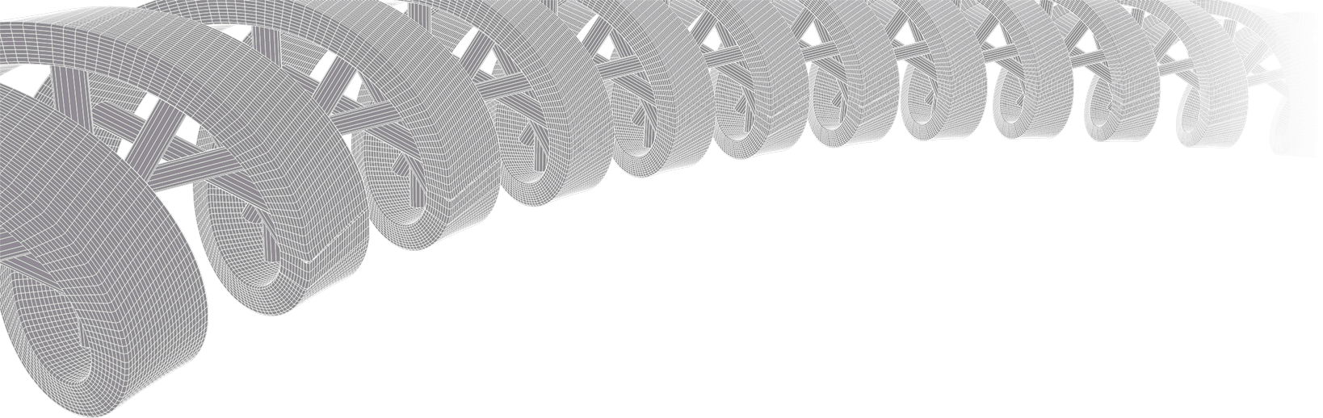
WORKSHOP ON GENOMICS: Genomic data visualization and interpretation
Malachi Griffith, Obi Griffith, Zachary Skidmore
Genomic Data Visualization and Interpretation
Jan 11, 2019
Český Krumlov, Czech Republic

Slide 2
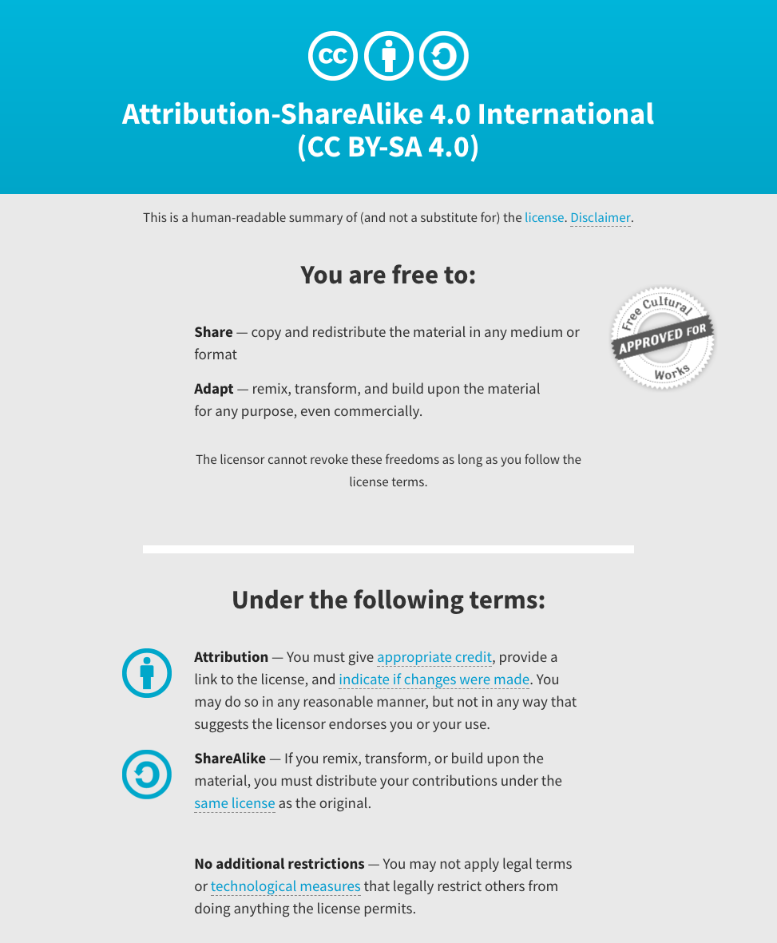
Notes:
Note there are two licenses if effect for this course.
All *content* (lectures, written materials, etc.) are made available under the Creative Commons Attribution-ShareAlike 4.0 International (CC BY-SA 4.0). (https://creativecommons.org/licenses/by-sa/4.0/).
All *code* (R scripts the website code itself) are made available under the MIT License (https://opensource.org/licenses/MIT).

Slide 3
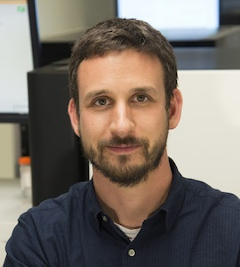
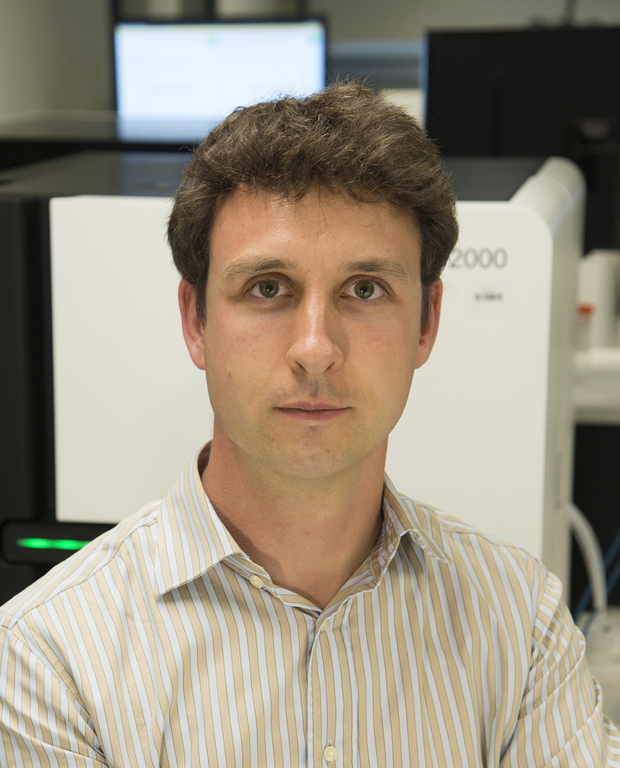
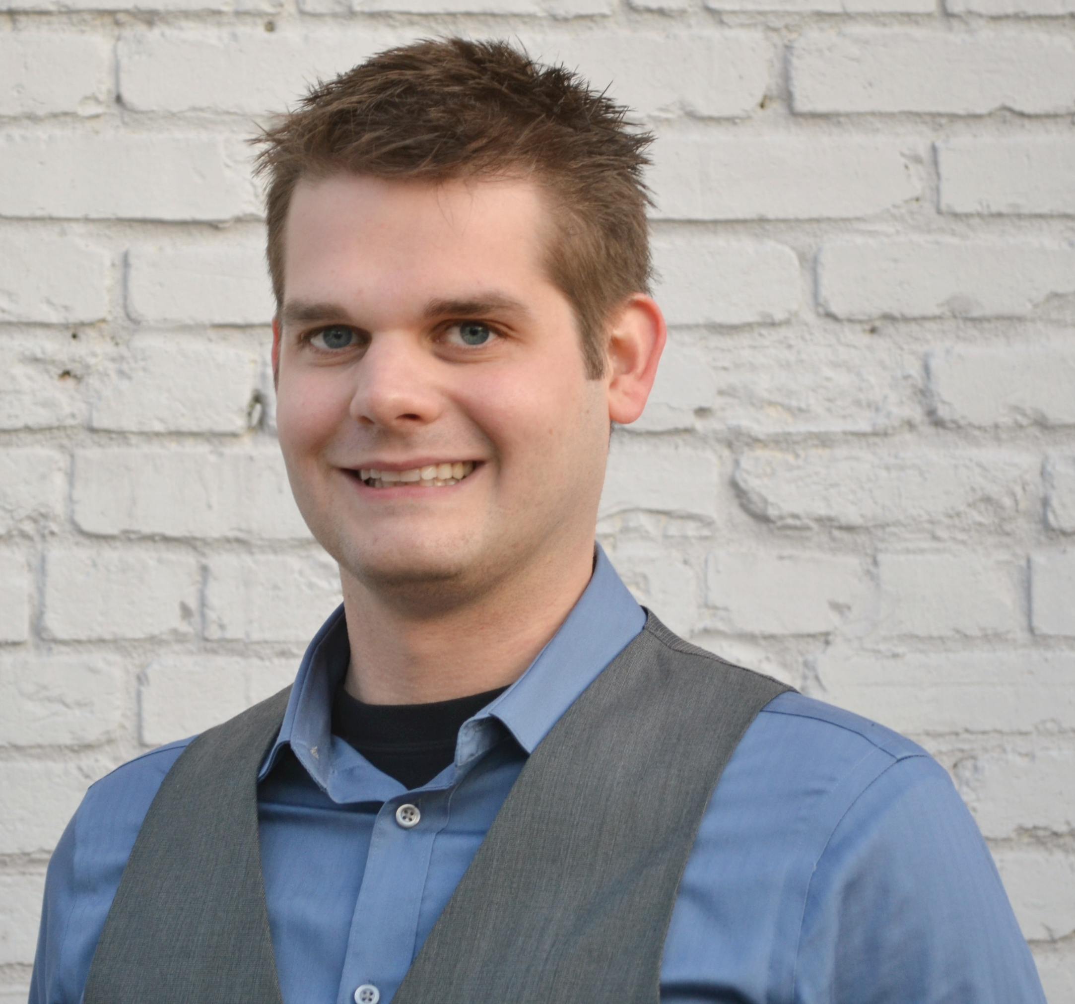
Introductions to course instructors
Malachi Griffith, PhD
Assistant Professor of Medicine Assistant Professor of Genetics
Assistant Director, MGI
Obi Griffith, PhD
Assistant Professor of Medicine Assistant Professor of Genetics
Assistant Director, MGI
Zachary Skidmore, MSc
Staff Scientist, MGI
GenVisR creator
McDonnell Genome Institute, Washington University School of Medicine

Slide 4
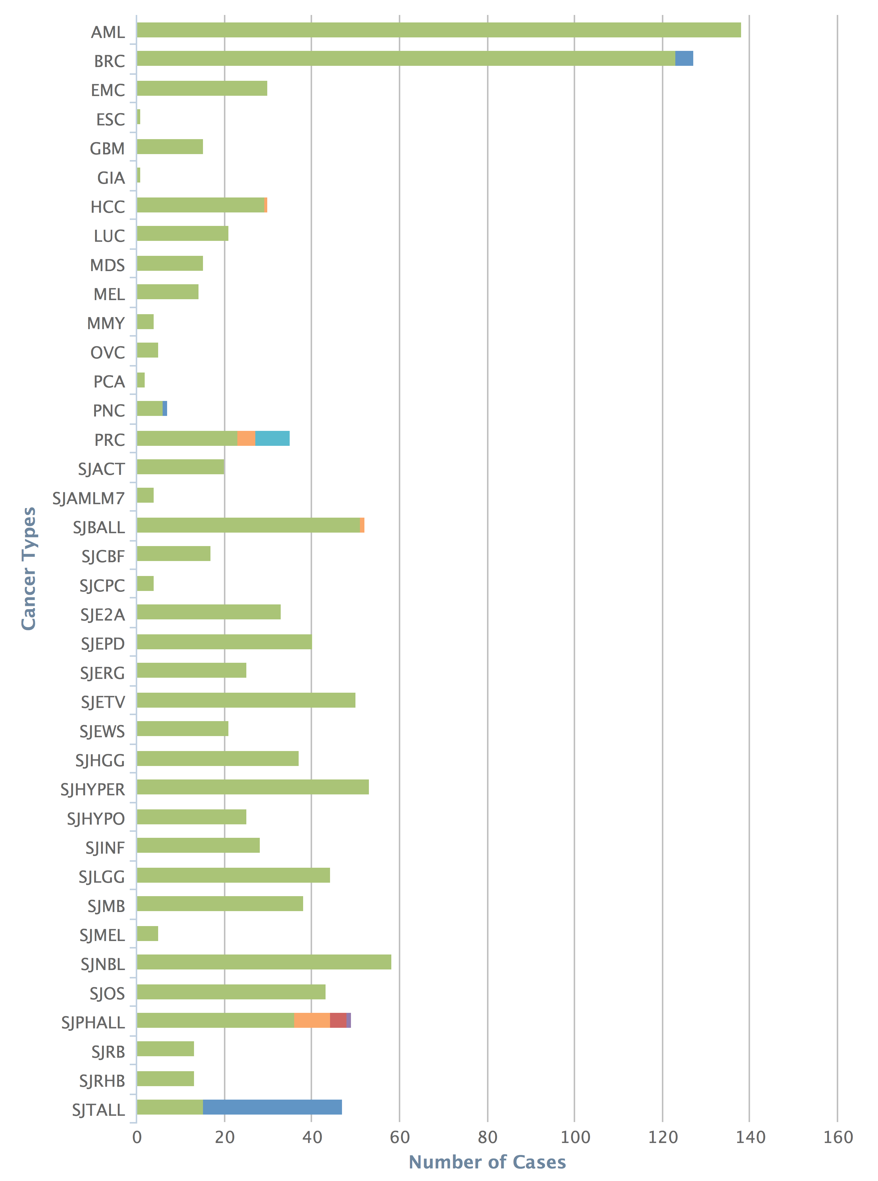
The McDonnell Genome Institute has pursued the field of genomics since inception: >1000 whole genomes, >5000 exomes, >1000 transcriptomes for dozens of tumor types
Human Genome Project
First to sequence and analyze a tumor whole genome sequence (Ley et al, 2008)
Major contributor to TCGA, PCGP, etc.
Most comprehensively sequenced single patient tumor ever published (Griffith et al, 2015)
Early proof-of-principle for cancer precision medicine (Griffith et al, 2016)
Analysis and tools for first personalized cancer vaccine design in humans (Carreno et al, 2015)
Many other widely used tools
Cancer types
Cases
MGI – 1000+ tumor whole genomes, many more exomes, X10 & NovaSeq will accelerate this!
Notes:
The McDonnell Genome Institute has been a leader in the field of cancer genome analysis from the first tumor genome to be sequenced (an AML case led by Dr. Tim Ley), to major contributions to large consortium efforts such as the Cancer Genome Atlas (TCGA) and Pediatric Cancer Genome Project (PCGP), to the most deeply sequenced individual tumor to date, to proof-of-principle cases for demonstrating the potential sequencing to guide cancer care, to the development of analysis methods and tools for some of the first trials of personalized cancer vaccines, and many other widely used tools. To date we have sequenced more than 1000 cancer whole genomes, more than 5000 whole exomes, and more than 1000 transcriptomes from dozens of tumor types. This represents a substantial fraction of the tumor genomes sequenced world wide.

Slide 5
Overview of lab’s research (griffithlab.org)
Cancer genome analysis
AML
Optimizing cancer genome analysis
Breast cancer
Immunotherapy (cancer vaccines)
STAT1-/- mouse model
Targeted sequencing of 625 ER+ with long-term follow-up
Liver cancer
Small cell lung cancer
OSCC
Etc…
Precision Medicine for Cancer
Genomics Tumor Board
Case Reports
Clinical Trials
Education projects
RNA-seq analysis and cloud computing (CBW, Toronto)
Advanced Sequencing Technologies and Applications (CSHL, New York)
Genomic Data Visualization/Interpretation (Physalia Courses, Berlin)
Precision Medicine Bioinformatics (PR Informatics, Glasgow)
High-Throughput Biology: From Sequence to Networks (CSHL / CBW, New York)
Workshop on Genomics (Evomics, Český Krumlov)
Tool development

Slide 6
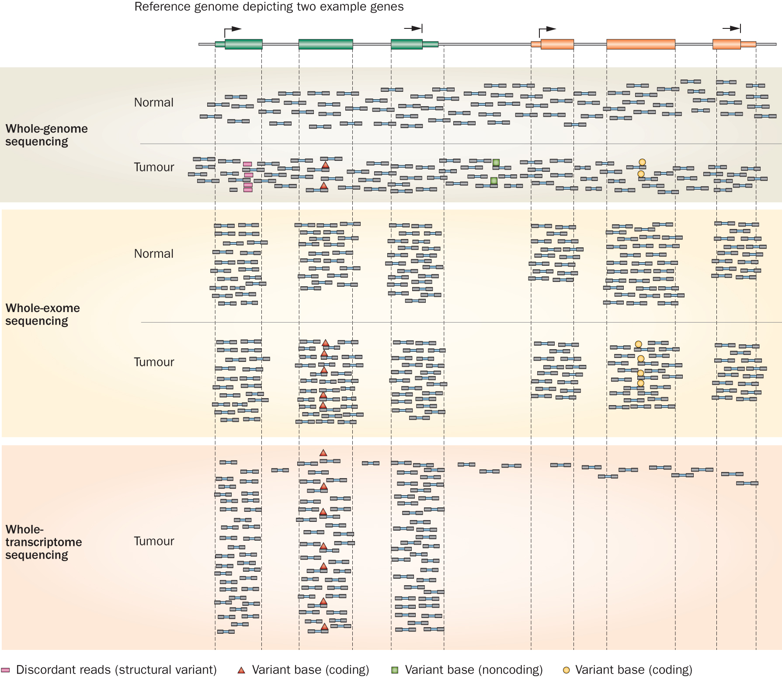
Whole genome, exome, transcriptome and other ‘omic’ sequencing allows us to detect and confirm many different variant types
‘WGS’
‘Exome’
‘RNA-seq’
Notes:
Each of these three data types, whole genome, exome and transcriptome, brings something to the table.
Whole genome gives you broad, even, and relatively unbiased coverage across the genome.
Exome gives you more focused coverage but much greater depth over the exons for a much lower cost than whole genome
RNA-seq gives you a snapshot of the transcriptome.

Slide 7
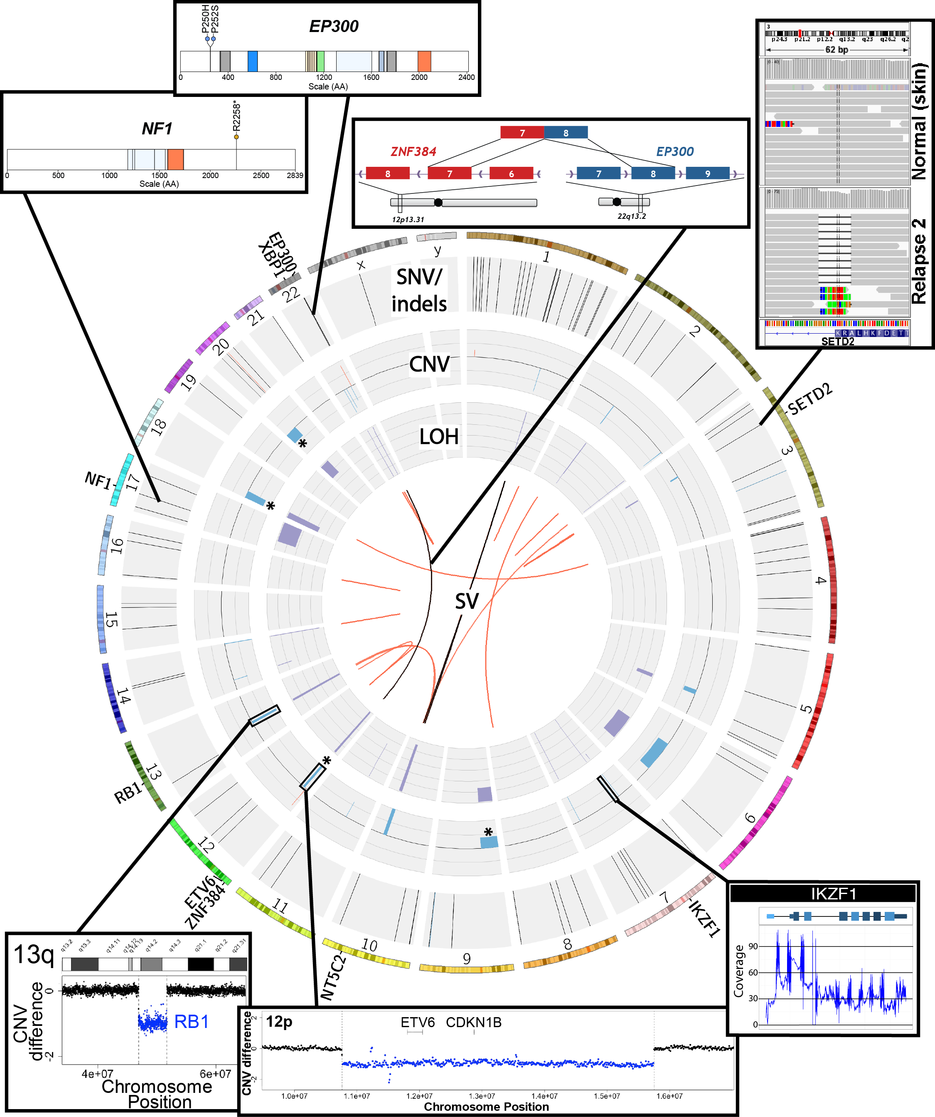
SNVs, Indels, CNVs, SVs, fusions, LOH, expression changes, methylation changes, and more
Notes:
Ultimately, an extremely comprehensive analysis was performed on this relapse tumor.
Many fascinating events were identified
The genome was characterized by a reasonable number of protein coding point mutations including those affecting EP300 and NF1.
While very little amplification was observed several rearrangements and both large and small deletions were apparent. These affected SETD2, XBP1, Ikaros, RB1, ETV6. SETD2 and NF1 were both hit twice.
An interesting EP300-ZNF384 fusion was identified.
At the time it was novel but has since been associated with other ALL patients.
While certainly interesting, none of these genomic events particularly suggested any clinical action.

Slide 8
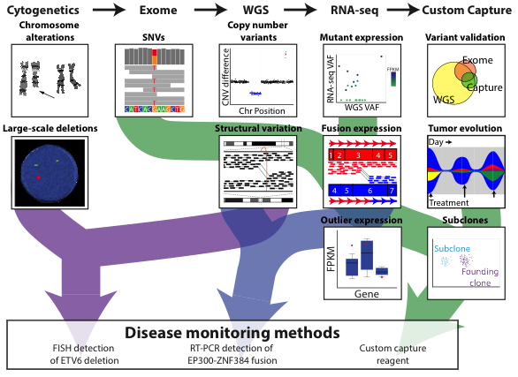
Comprehensive and integrative analysis methods are needed
Kilannin Krysiak
Notes:
As a proof-of-principle we took a very comprehensive approach. Though we balanced this with the need to complete data generation and a first version of the analysis quickly (41 days from receipt of sample to return of information).
By this time (2nd relapse), the patient had an extensive cytogenetics workup. To this we added exome, whole genome and RNA-seq.
Based on the WGS data we also created a custom NimbleGen capture reagent to cover all SNVs in the patient.
We used these data to identify SNVs and Indels, copy number variants, SVs, expressed variants, fusions, and outlier gene expression events.
The custom capture data was used largely to monitor disease burden in bone marrow samples obtained subsequent to the second relapse (and historical samples that were previously banked).

Slide 9
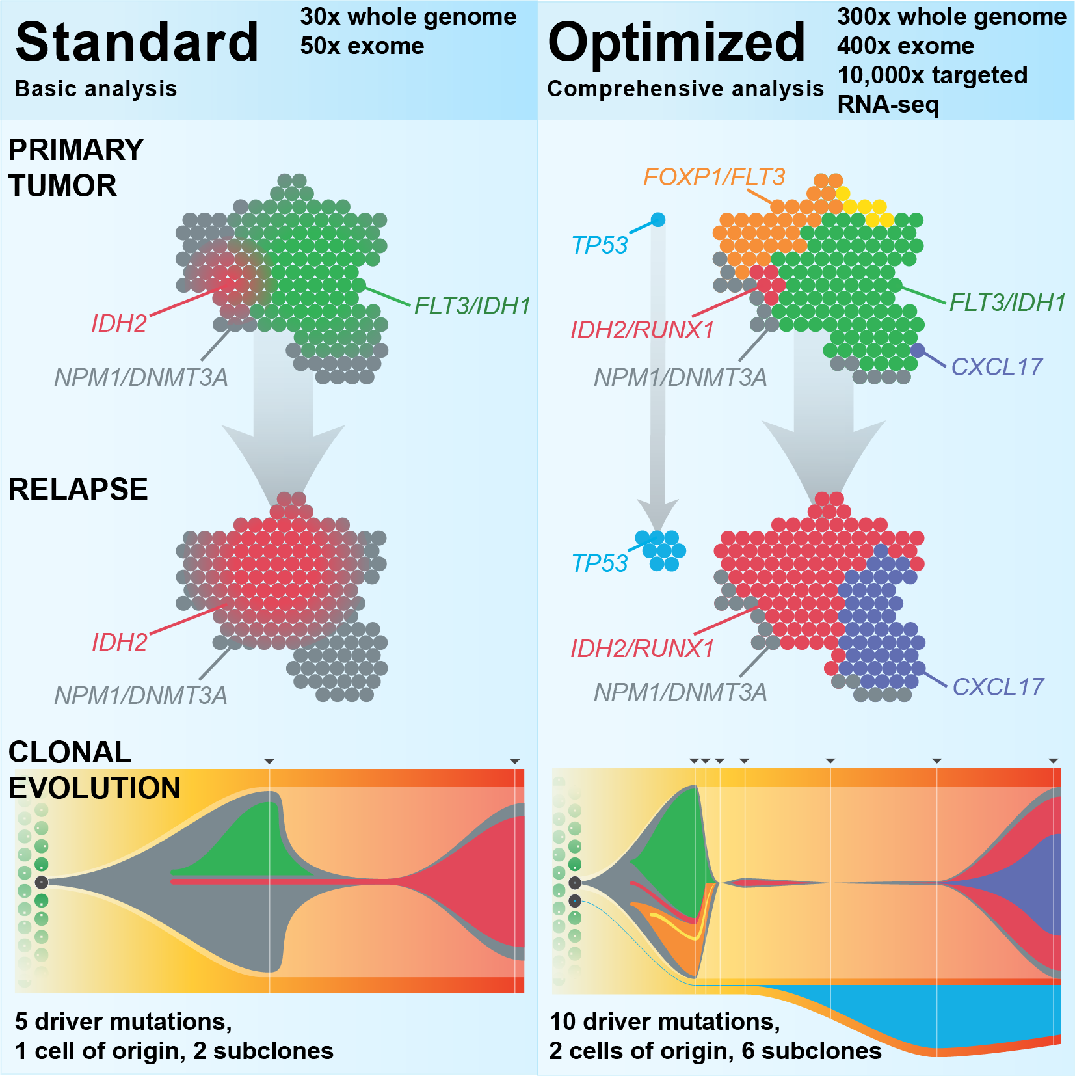
Each study often requires considerable customization
Griffith et al. 2015
Kilannin Krysiak

Slide 10
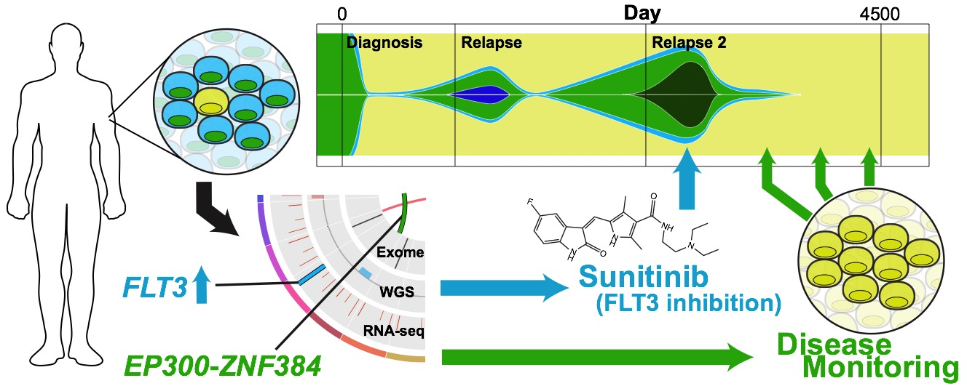
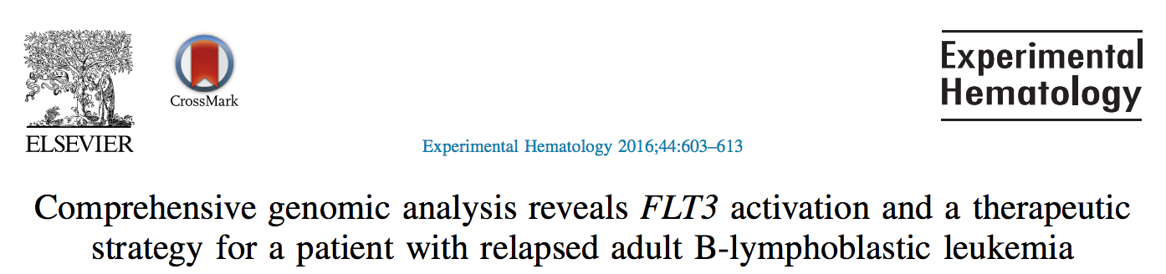
Personalized medicine requires personalized strategies
Griffith et al. 2016
Kilannin Krysiak

Slide 11
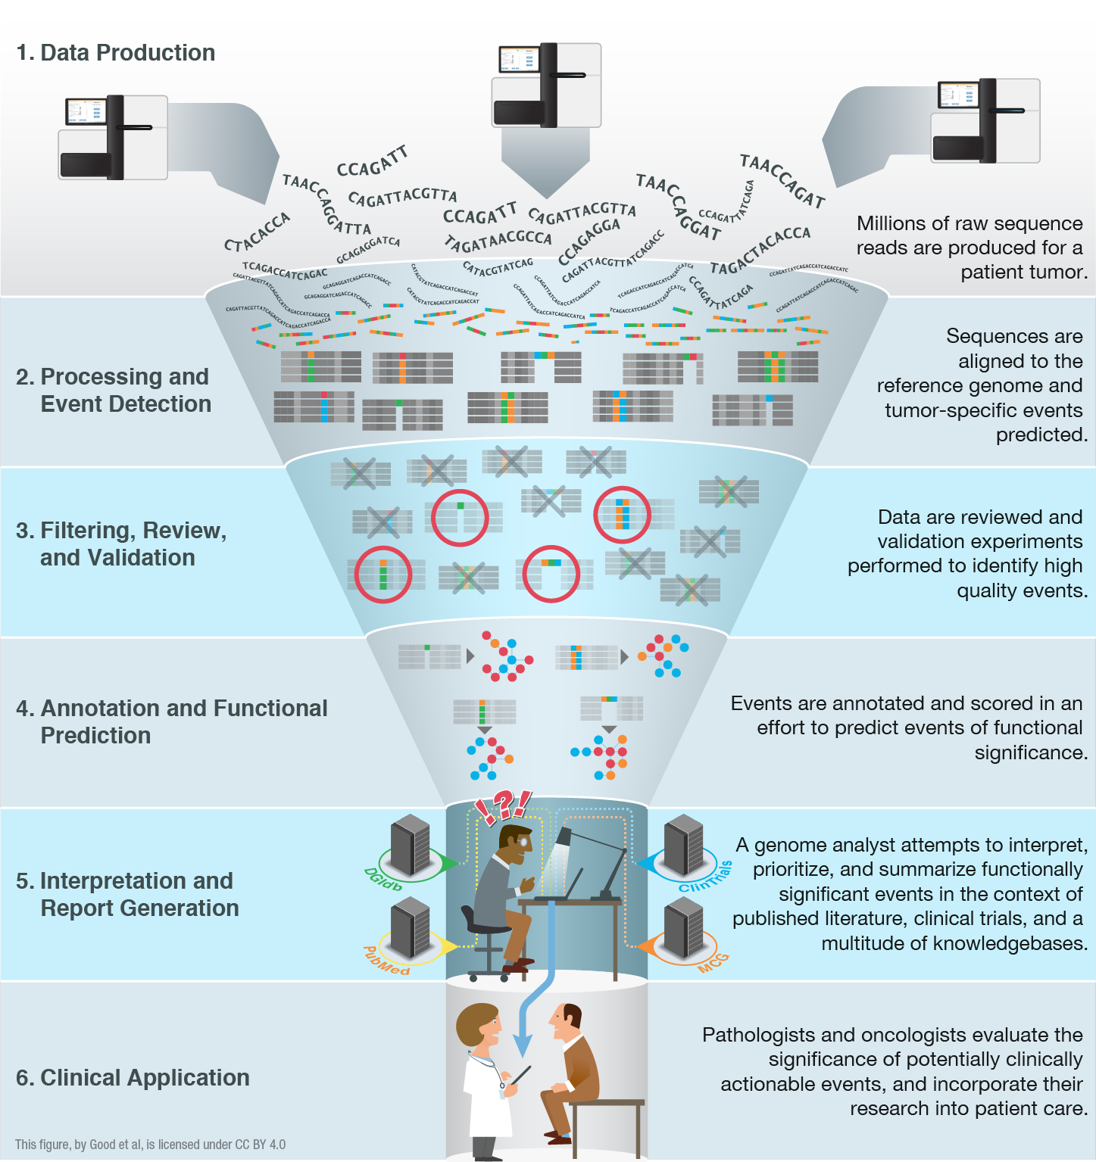
High-throughput sequencing has been largely automated allowing rapid identification of somatic and germline variants
Good BM, Ainscough BJ, McMichael JF, Su AI, Griffith OL. 2014. Genome Biology. 15(8):438.
Joshua McMichael
Notes:
We have an embarrassment of riches with all of the –omic events now being detected (though there is plenty of room for improvement!).
We are starting to have a handle on doing this routinely and quickly. We can generate the raw data, feed it into automated pipelines that process the data and predict genomic events. Filtering, review and validation thins these lists down to somewhat tractable counts of 10s to 100s of events. Where we are really stuck now is at the interpretation and report generation stage. This is a major bottleneck. The ‘genome analysts’ who have the skill sets to assemble final reports that a clinician might find useful are completely swamped.
One way to address this I already talked about. Education. We can train more of these genomics experts. But we also need to harness informatics strategies to make their job easier and address the bottleneck. With that in mind we are pursuing various data mining, crowd sourcing, natural language processing, etc.

Slide 12
Interpretation and visualization of genomic alterations remains the bottleneck for realizing precision medicine
Good BM, Ainscough BJ, McMichael JF, Su AI, Griffith OL. 2014. Genome Biology. 15(8):438.
Joshua McMichael
Notes:
We have an embarrassment of riches with all of the –omic events now being detected (though there is plenty of room for improvement!).
We are starting to have a handle on doing this routinely and quickly. We can generate the raw data, feed it into automated pipelines that process the data and predict genomic events. Filtering, review and validation thins these lists down to somewhat tractable counts of 10s to 100s of events. Where we are really stuck now is at the interpretation and report generation stage. This is a major bottleneck. The ‘genome analysts’ who have the skill sets to assemble final reports that a clinician might find useful are completely swamped.
One way to address this I already talked about. Education. We can train more of these genomics experts. But we also need to harness informatics strategies to make their job easier and address the bottleneck. With that in mind we are pursuing various data mining, crowd sourcing, natural language processing, etc.

Slide 13
cfDNA and immunogenomics slides

Slide 14

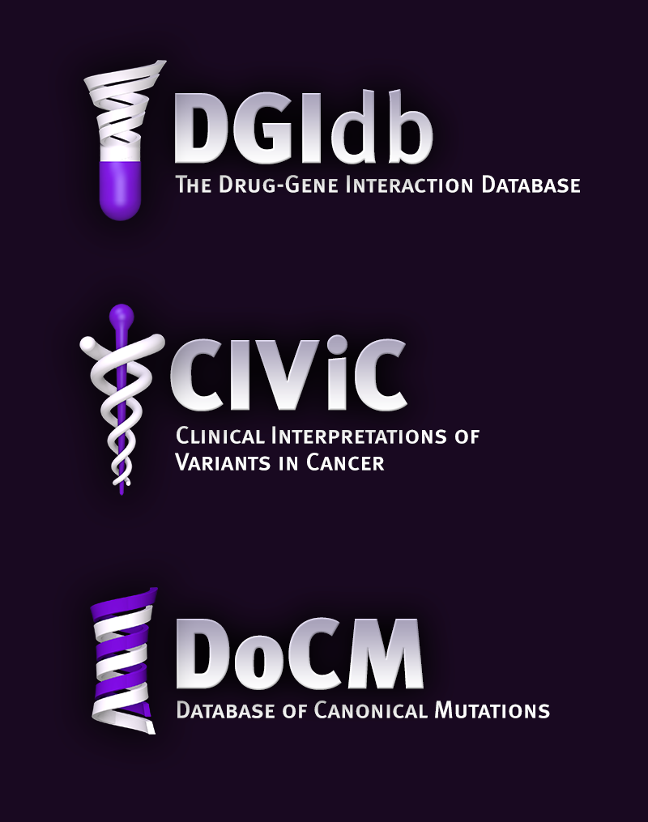

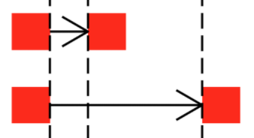
Where tools/resources do not exist we build them
www.dgidb.org
Search genes for known and potentially druggable interactions
https://github.com/griffithlab/pVAC-Seq
Personalize vaccine design
www.docm.info
Filter against highly curated set of mutations known to cause cancer
GenVisR
https://github.com/griffithlab/GenVisR
Create genomic visualizations
www.civicdb.org
Identify highly curated summaries of clinical interpretations for variants in cancer
regtools
https://github.com/griffithlab/regtools
Identify regulatory variants

Slide 15
Introduction

Slide 16
Why do we create visualizations of genomic data?
Data exploration and interpretation of results
QC analysis
Understanding whether/how an experiment worked
Discovery
Communication
Slides for presentations
e.g. Keynote, Powerpoint, etc.
Figures for publications
e.g. PDFs, PNGs, etc.

Slide 17
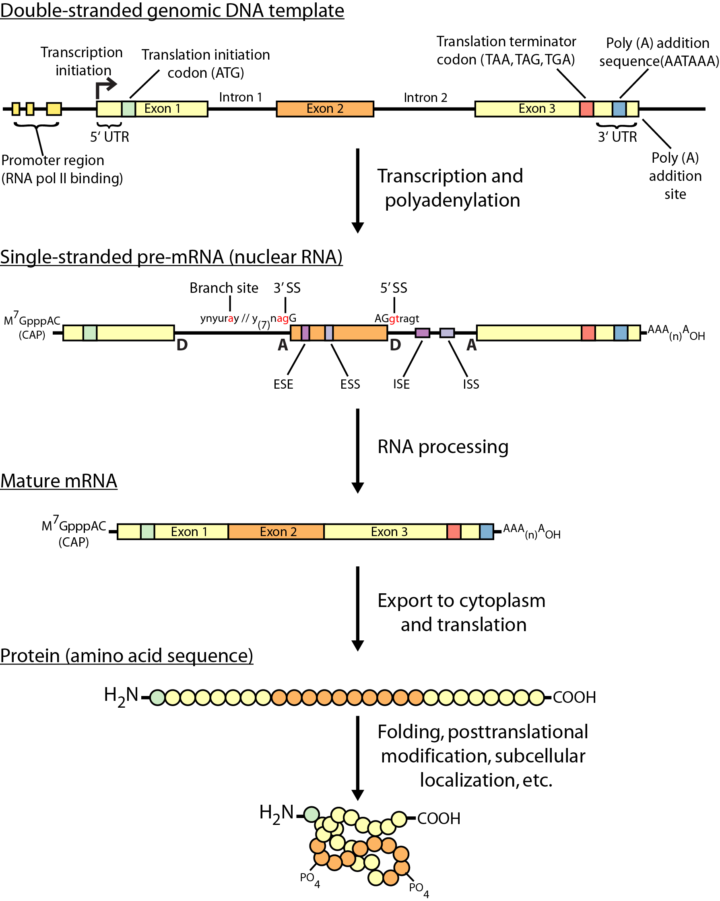
Review of central dogma

Slide 18
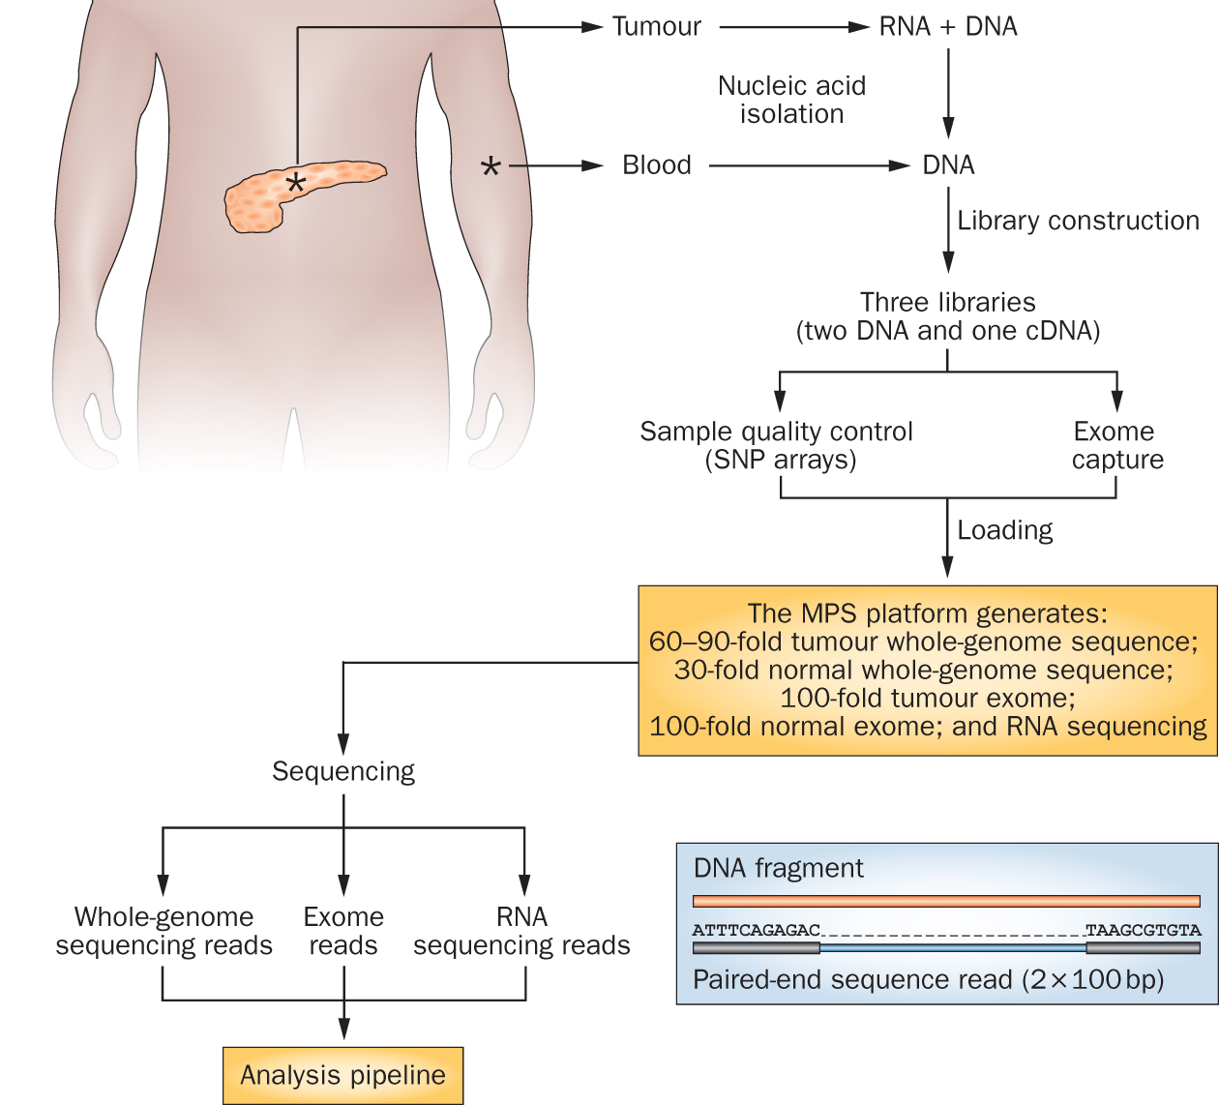
Genomics research has exploded with the rapid advances in DNA sequencing technologies
Notes:
We sequence a lot of things at the Genome Institute. But my research interest is fairly focused on clinical cancer sequencing. The idea here is that we start with a patient, sometimes starting at diagnosis but often starting at the point where they have exhausted standard of care options.
From these patients we get a tumor sample and a reference normal sample (usually blood). From the tumor we isolate DNA and RNA and from the normal we isolated DNA. This trio of samples is subjected to library construction followed by whole genome, exome, and transcriptome sequencing. This data flows into our analysis systems and we attempt to detect somatic events that might be relevant to cancer biology or treatment. This involves detecting single nucleotide variants, small insertions and deletions, large copy number amplifications and deletions, gene and isoform expression levels, structure rearrangements, expressed gene fusions, and detection of tumor associated viruses.

Slide 19
Whole genome, exome and transcriptome sequencing allows us to detect and confirm many different variant types
‘WGS’
‘Exome’
‘RNA-seq’
Notes:
Each of these three data types, whole genome, exome and transcriptome, brings something to the table.
Whole genome gives you broad, even, and relatively unbiased coverage across the genome.
Exome gives you more focused coverage but much greater depth over the exons for a much lower cost than whole genome
RNA-seq gives you a snapshot of the transcriptome.

Slide 20
Interactive exercise on interpretation of data

Slide 21
Genome browsers

Slide 22
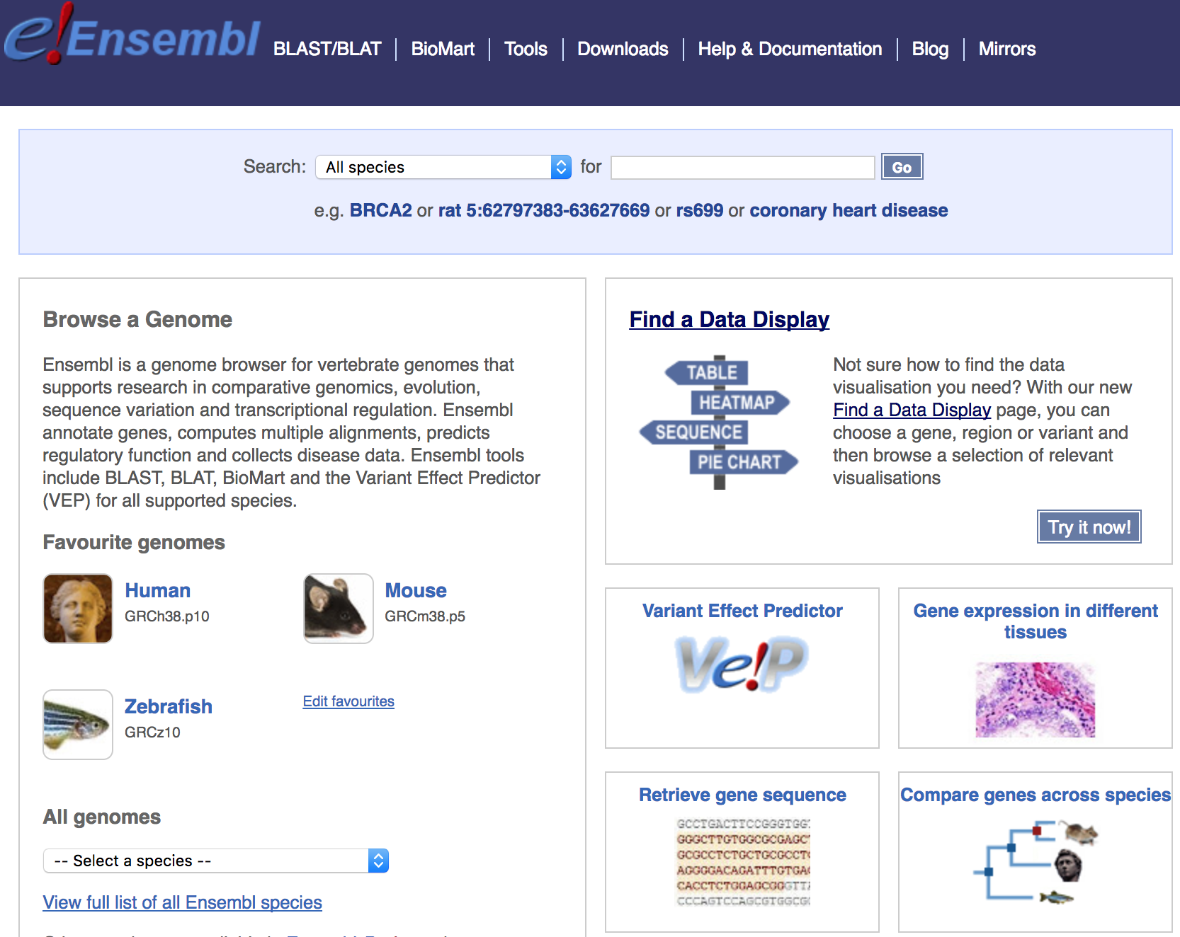
Genome browsers - Ensembl

Slide 23
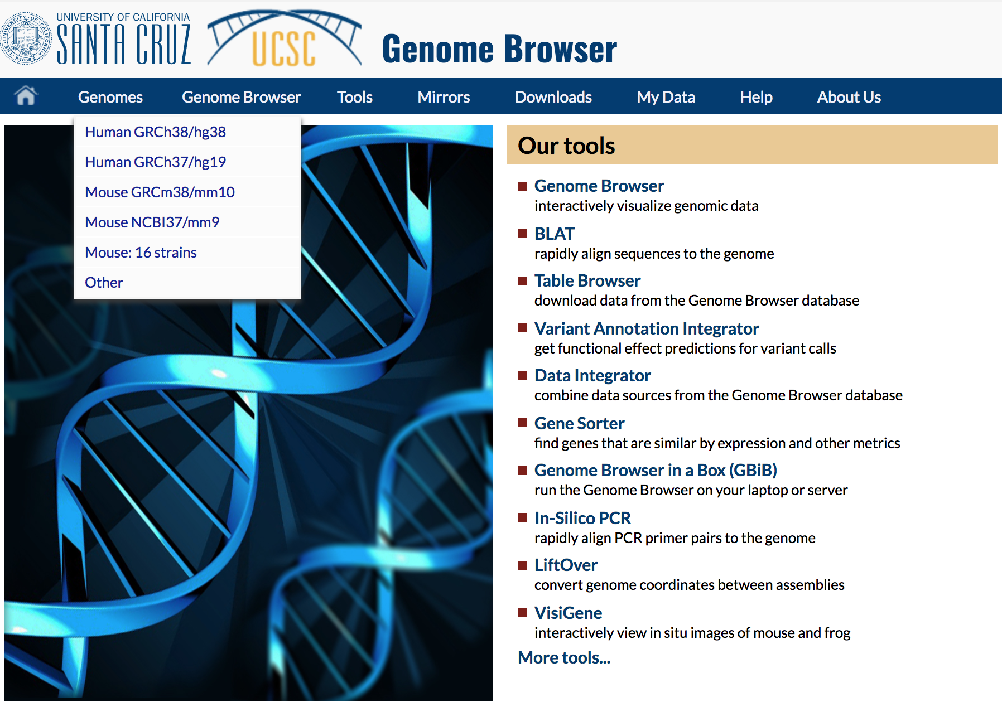
Genome browsers - UCSC

Slide 24
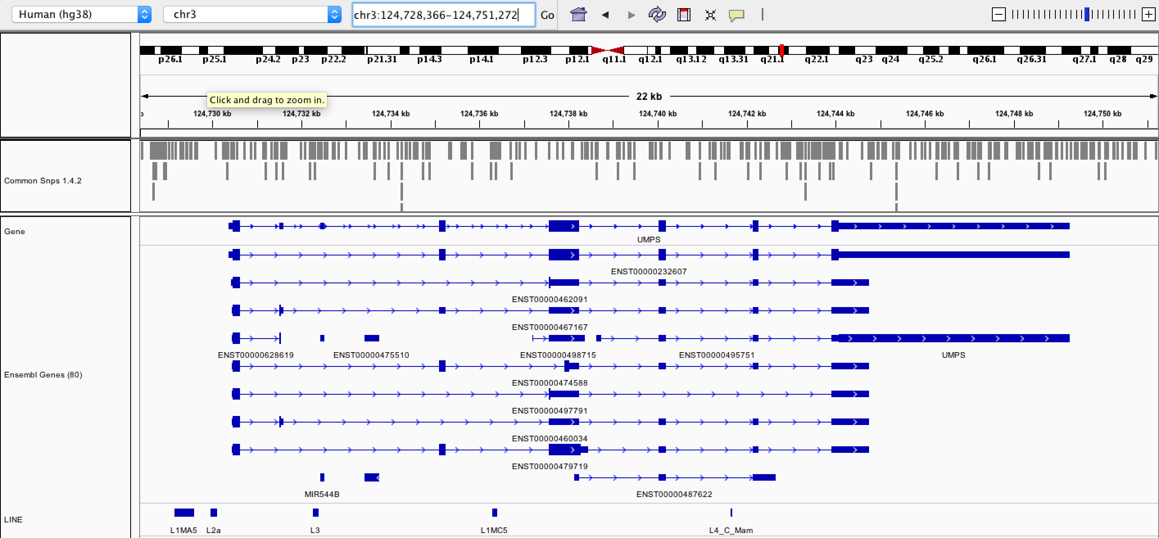
Genome browsers - IGV

Slide 25
Fundamentals of data visualization

Slide 26
Fundamentals of data visualization
Where to learn more about the art and science of visualization:
Collection of 40 Nature Methods articles on data visualization: “Points of View” Articles
Resources for choosing colors
http://colorbrewer2.org/
http://mkweb.bcgsc.ca/color/
Understanding and using Color Palettes
Credit to Martin Krzywinski for his extensive work in this area and many of the above resources

Slide 27
Best practices in visualization

Slide 28
Best practices from this workshop
*Always* label axes
Consider readability of font size
Avoid vertical or angled text if possible
Avoid unnecessary use of color, point shapes, etc.
Chose colors wisely
If individual data points are being plotted and have started to really pile up on top of each other consider using a density function
Always be transparent about what data manipulation is taking place (e.g. log scale, filtering of outliers, etc.)

Slide 29
Best practices from the experts
Ten Simple Rules for Better Figures (Rougier et al. 2014):
Scientific visualizations should act as a “a graphical interface between people and data”. Try to follow these rules.
Know Your Audience
Identify Your Message
Adapt the Figure to the Support Medium
Captions Are Not Optional
Do Not Trust the Defaults
Use Color Effectively
Do Not Mislead the Reader
Avoid “Chartjunk”
Message Trumps Beauty
Get the Right Tool

Slide 30
Example visualizations using R

Slide 31
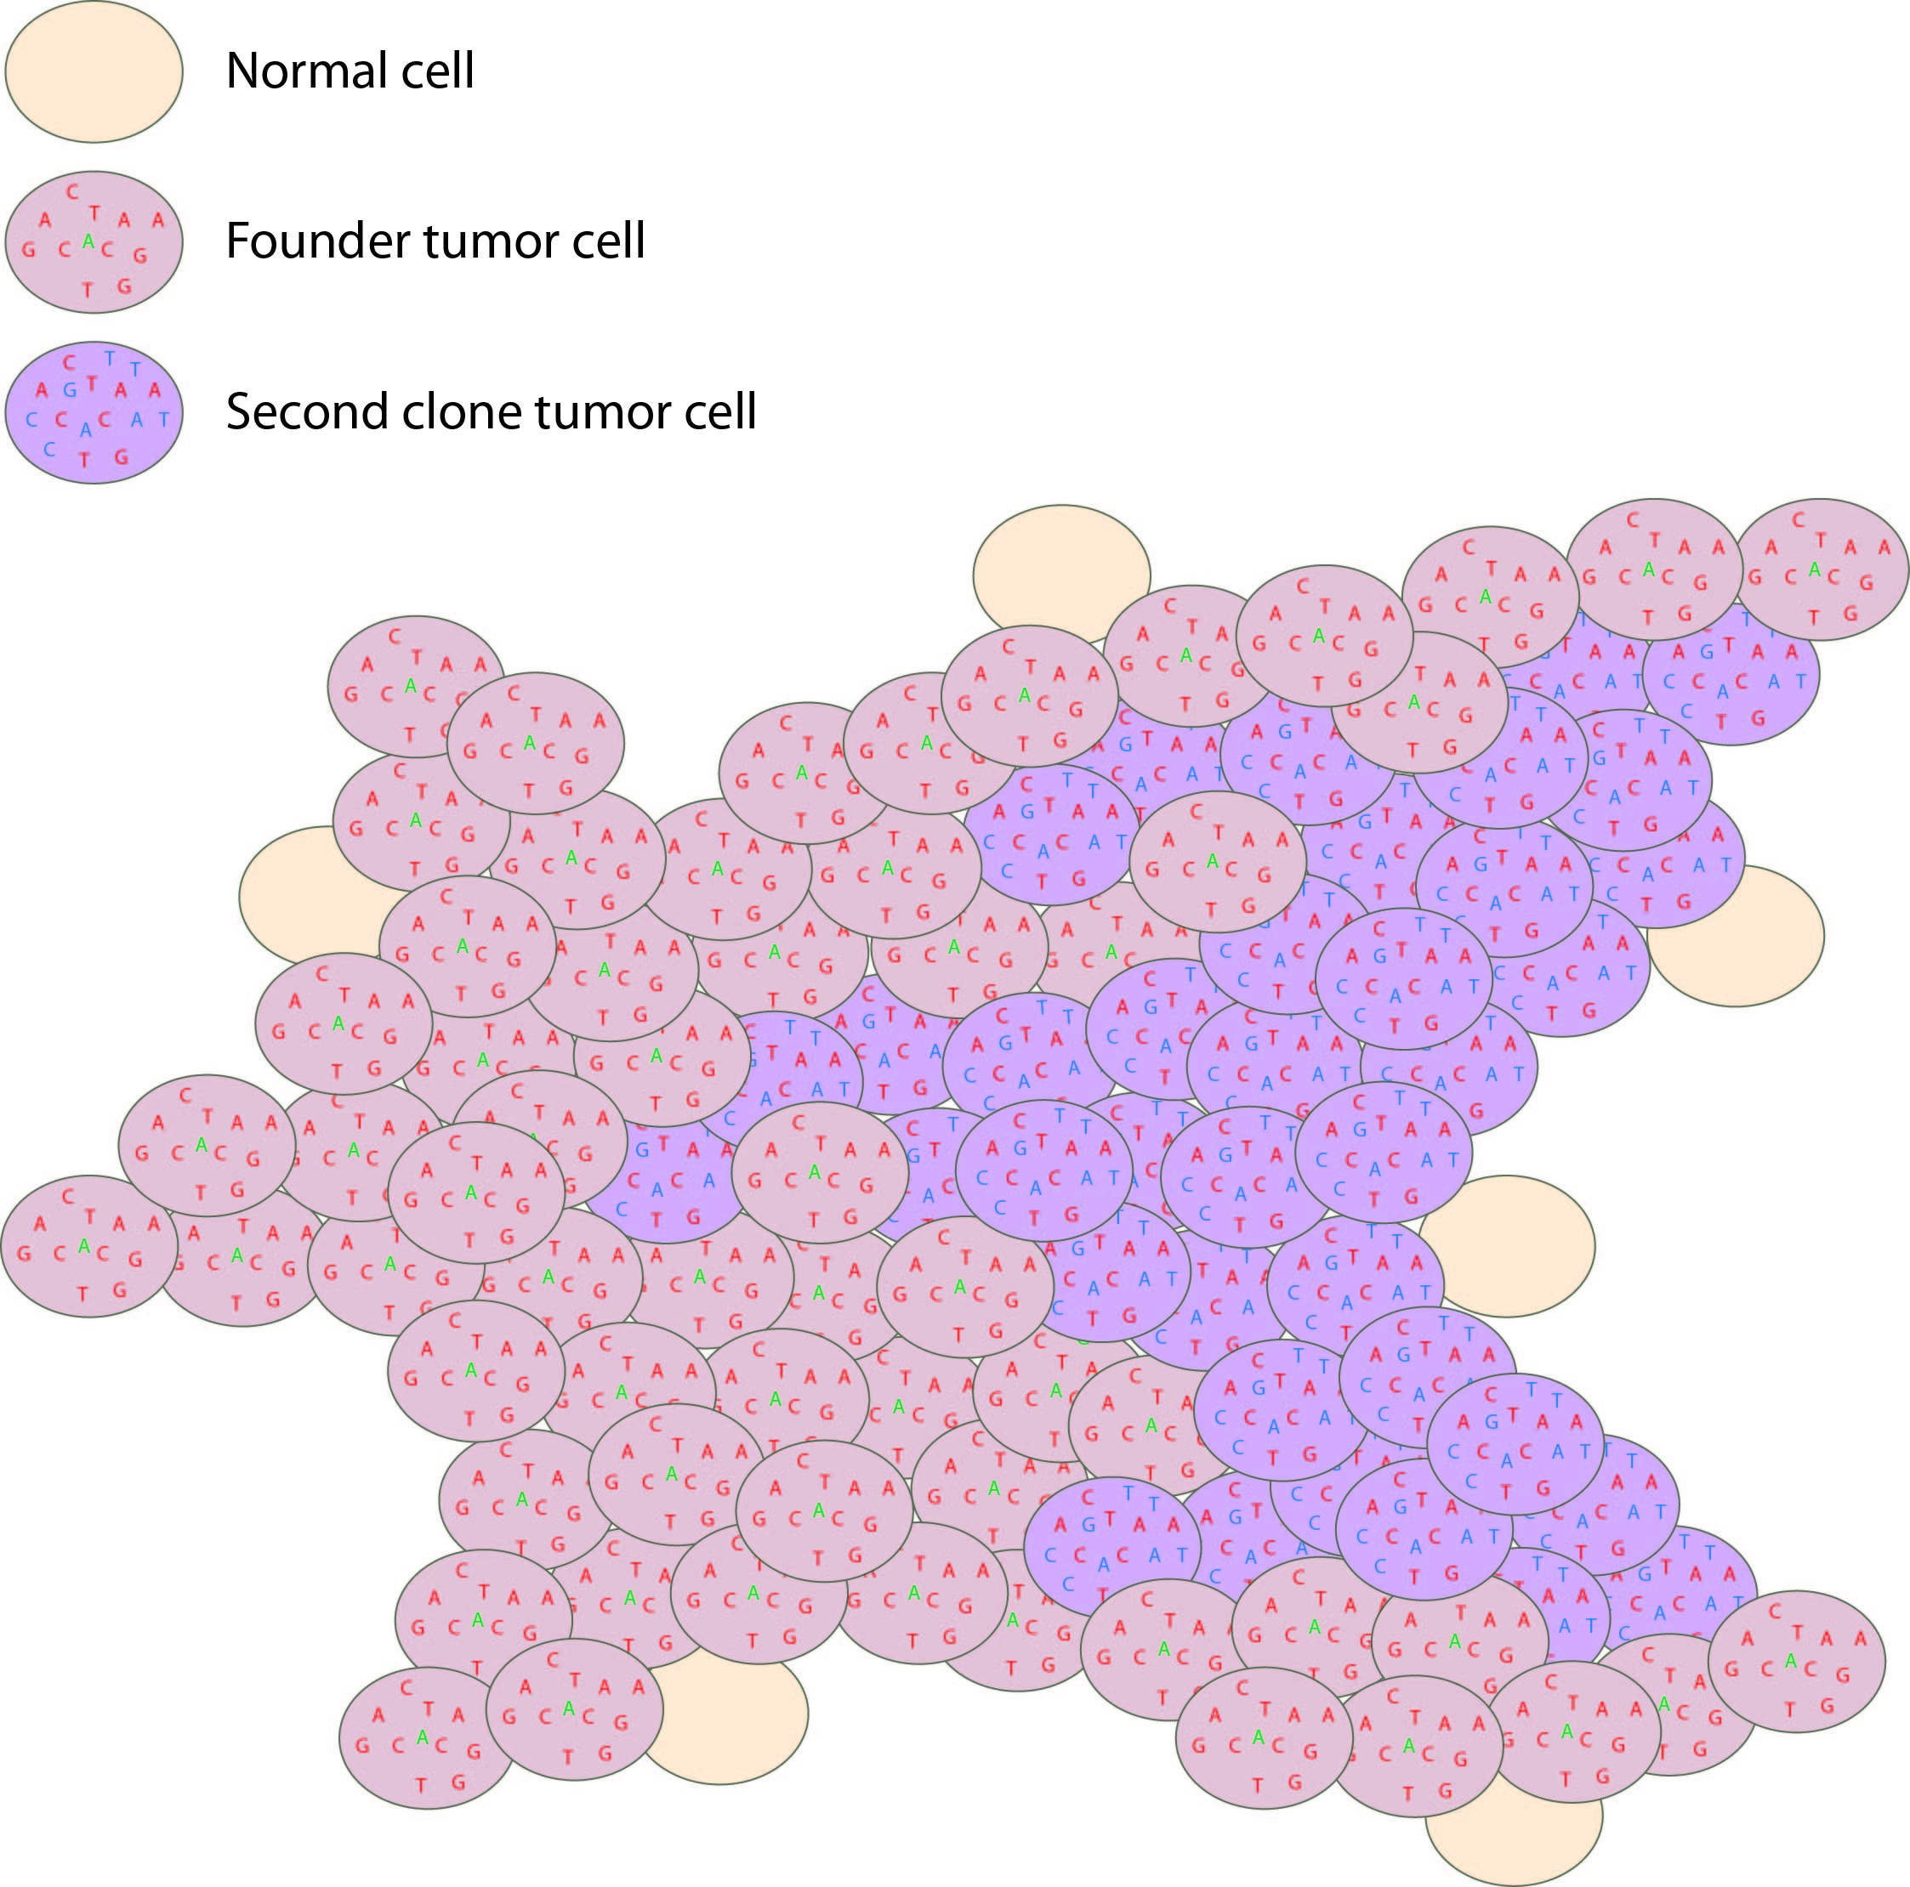
Histogram and scatterplot to define cell populations
Tumor variant allele frequency
Proportion
NF1
Read coverage (X)
WGS data
Tumor variant allele frequency
Tumor variant allele frequency

Slide 32
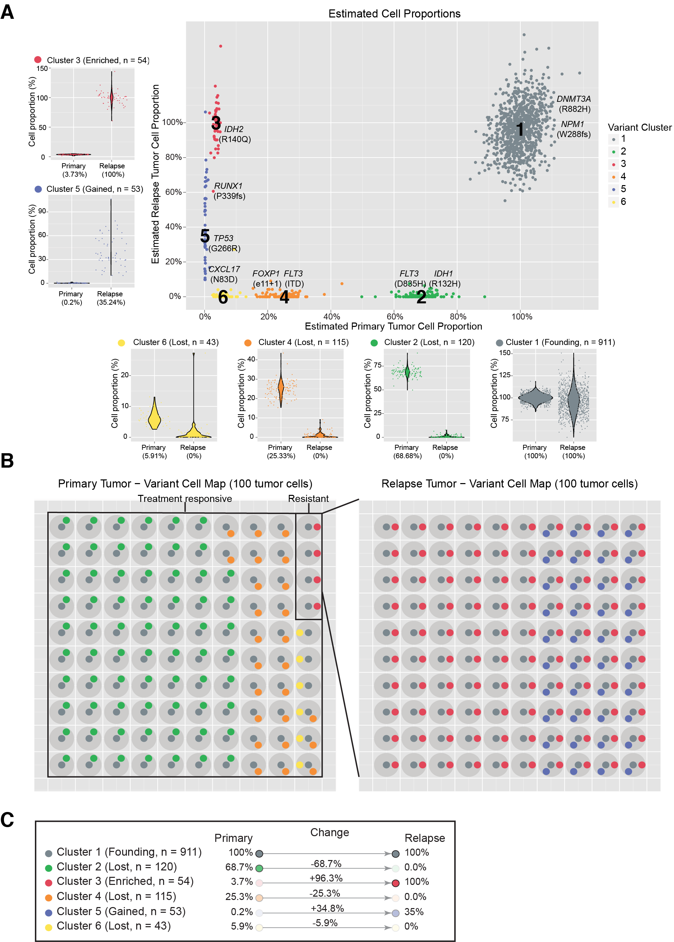
Clustering to define to distinct cell populations
Notes:
If we overlay each of these mutations on the rest of the platinum variants and use a clonality inference tools like SciClone we can resolve 6 different sub-clones, each with a couple driver mutations present. Except sub-clone 6. Based on our experiences so far we probably still haven’t sequenced deeply enough to find a driver event in that sub-clone yet.
You can see how in each of the surrounding plots, a shift in VAF distribution is occurring between primary and relapse.

Slide 33
Using a “cell map” to represent the variant clusters in 100 hypothetical cells of a tissue

Slide 34
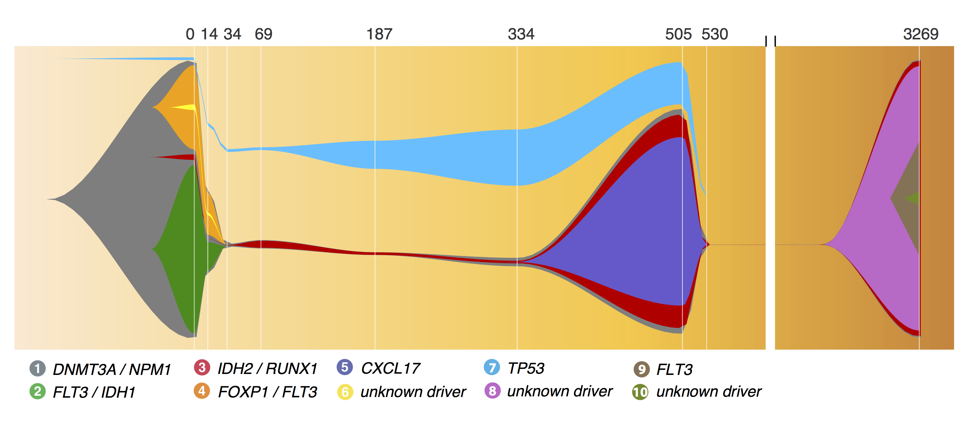
A ‘fish’ plot is used to represent sub-clones lost and gained over time

Slide 35
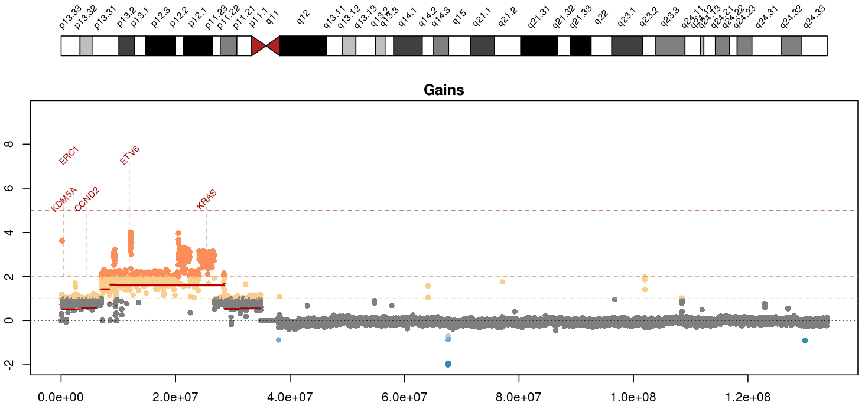
Visualizing copy number variation
Mean tumor-normal depth per 10kb window plotted
KRAS amplification in a metastatic breast cancer
Notes:
Whole genome data is exceptionally good a detecting copy number alterations in tumors. You essentially get a beautiful digital karyotype for each tumor. Here we see a complex amplification affecting KRAS and ETV6 and other critical cancer genes by both single copy and two copy gains.
We currently use cnv-hmm, CopyCat, and CnView for this kind of copy number analysis

Slide 36
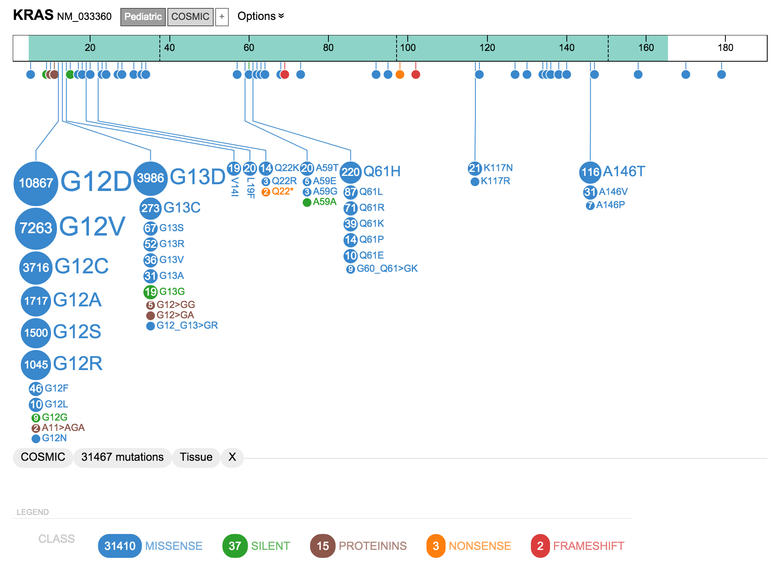
A ‘lollipop’ plot is used to variant recurrence in a gene
* Actually this one used “ProteinPaint” a web based tool we will try

Slide 37
A ‘waterfall’ plot is one way to visualize the pattern of recurrence in a cohort
https://github.com/griffithlab/GenVisR

Slide 38
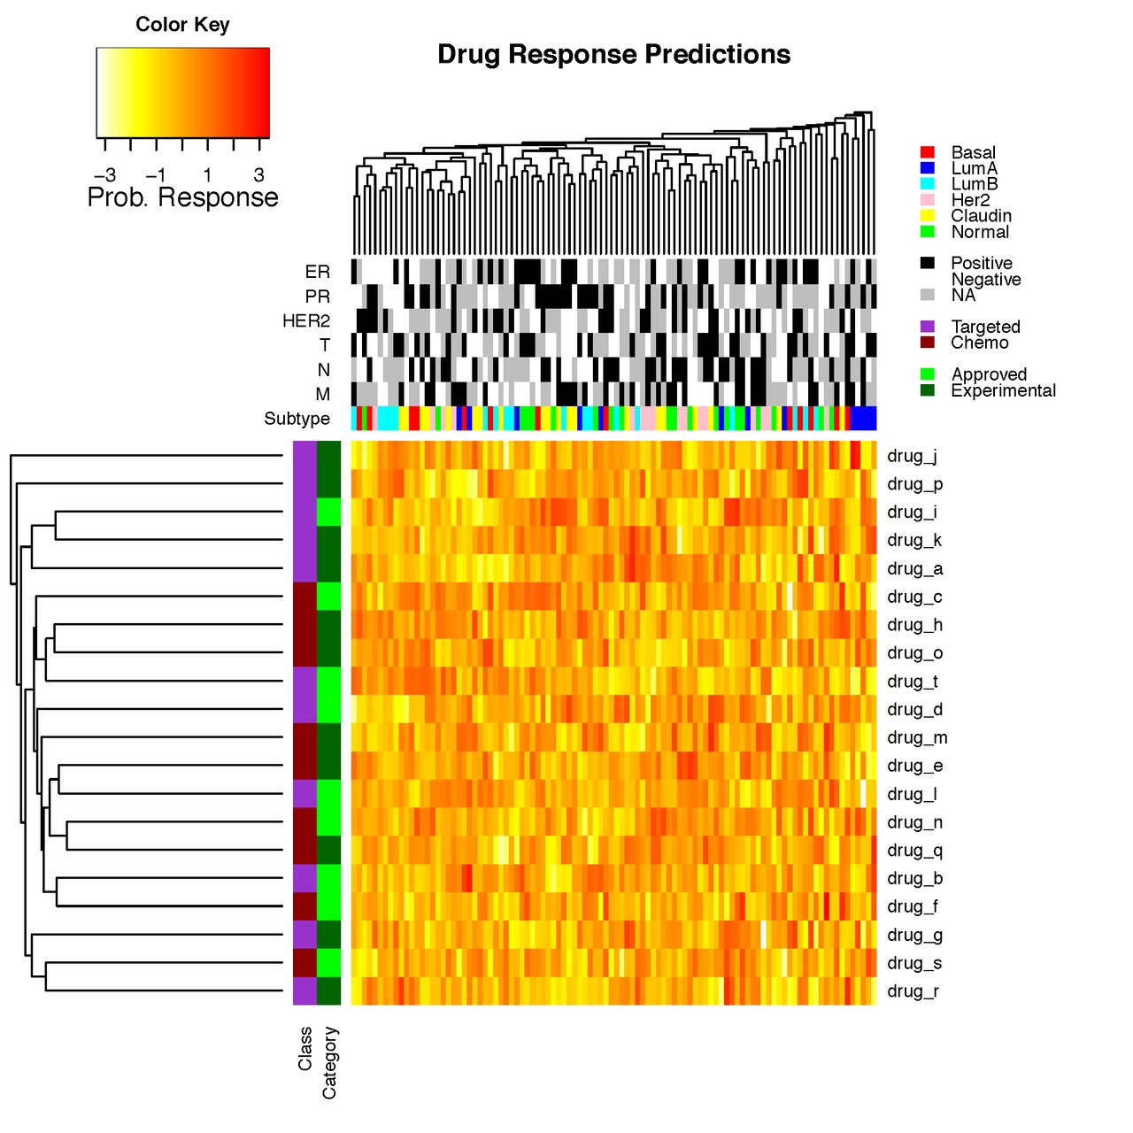
Heatmaps are a common way to simultaneously visualize multiple features of a dataset

Slide 39
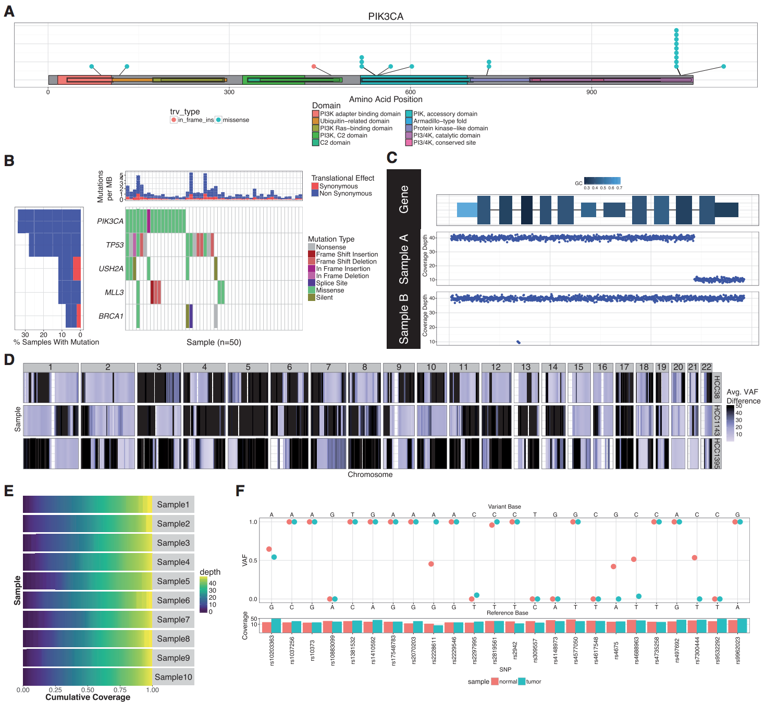
GenVisR was created to help others make common genomic visualizations

Slide 40
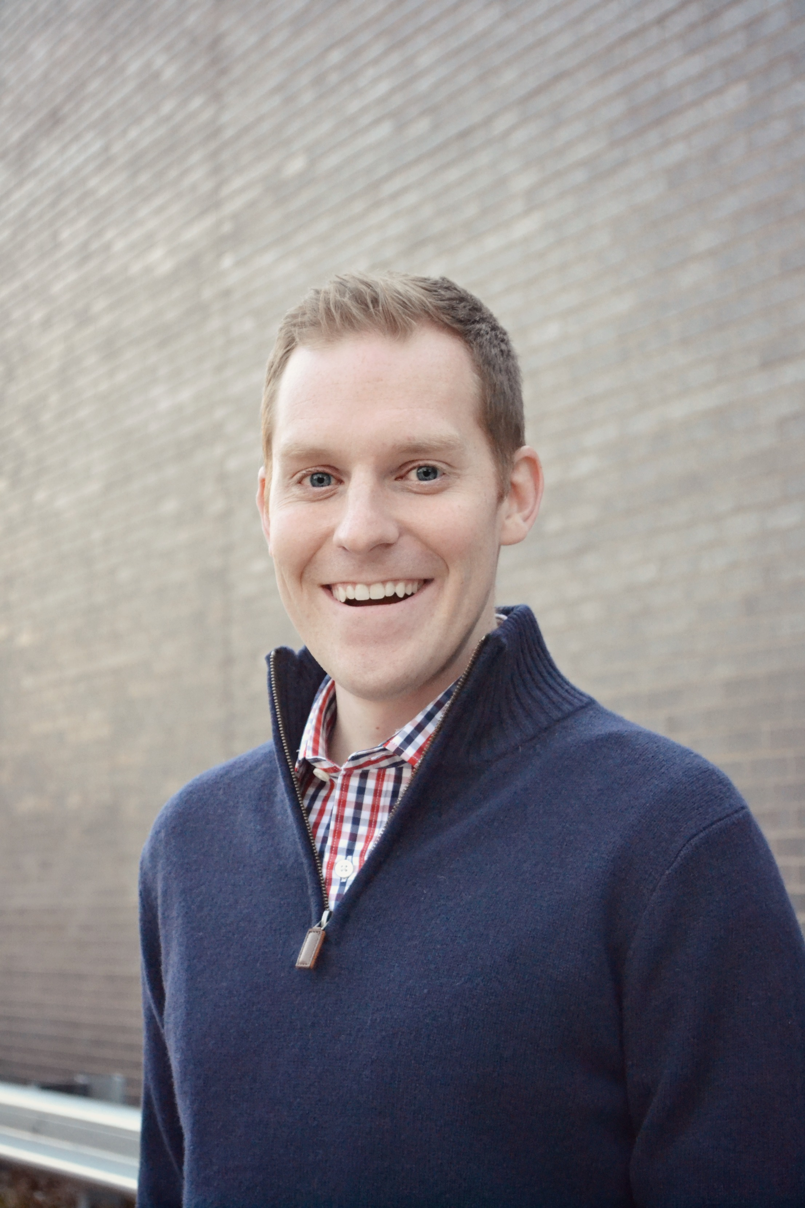
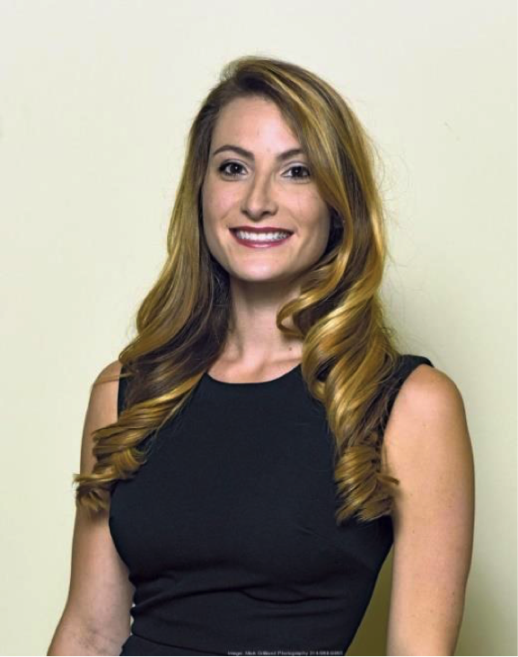
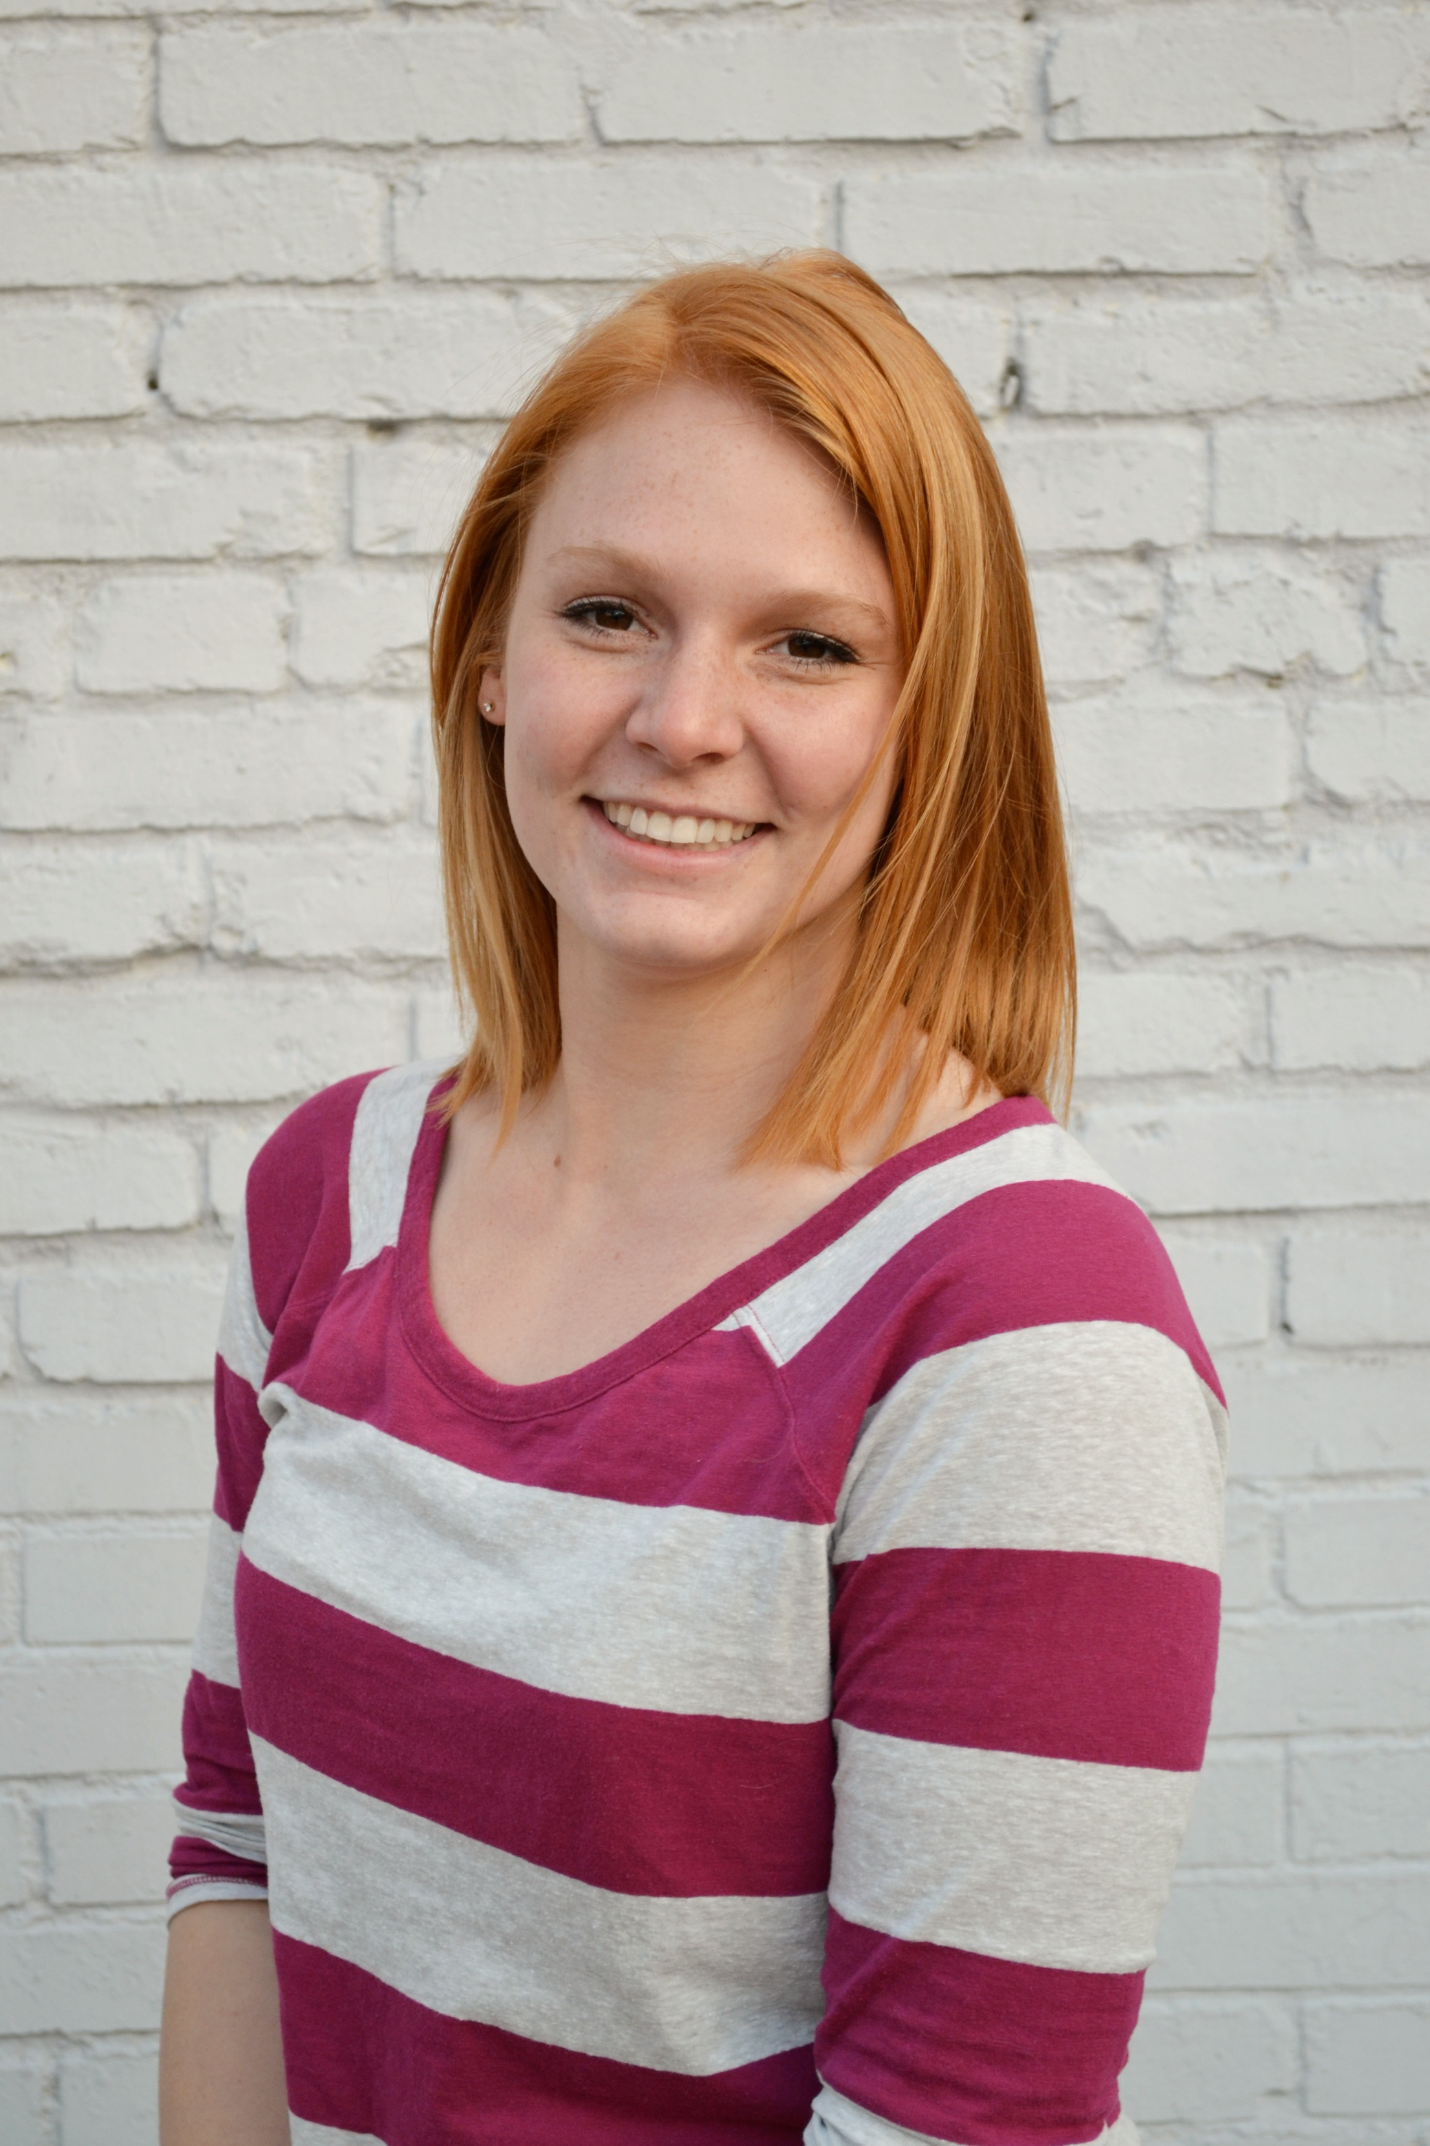
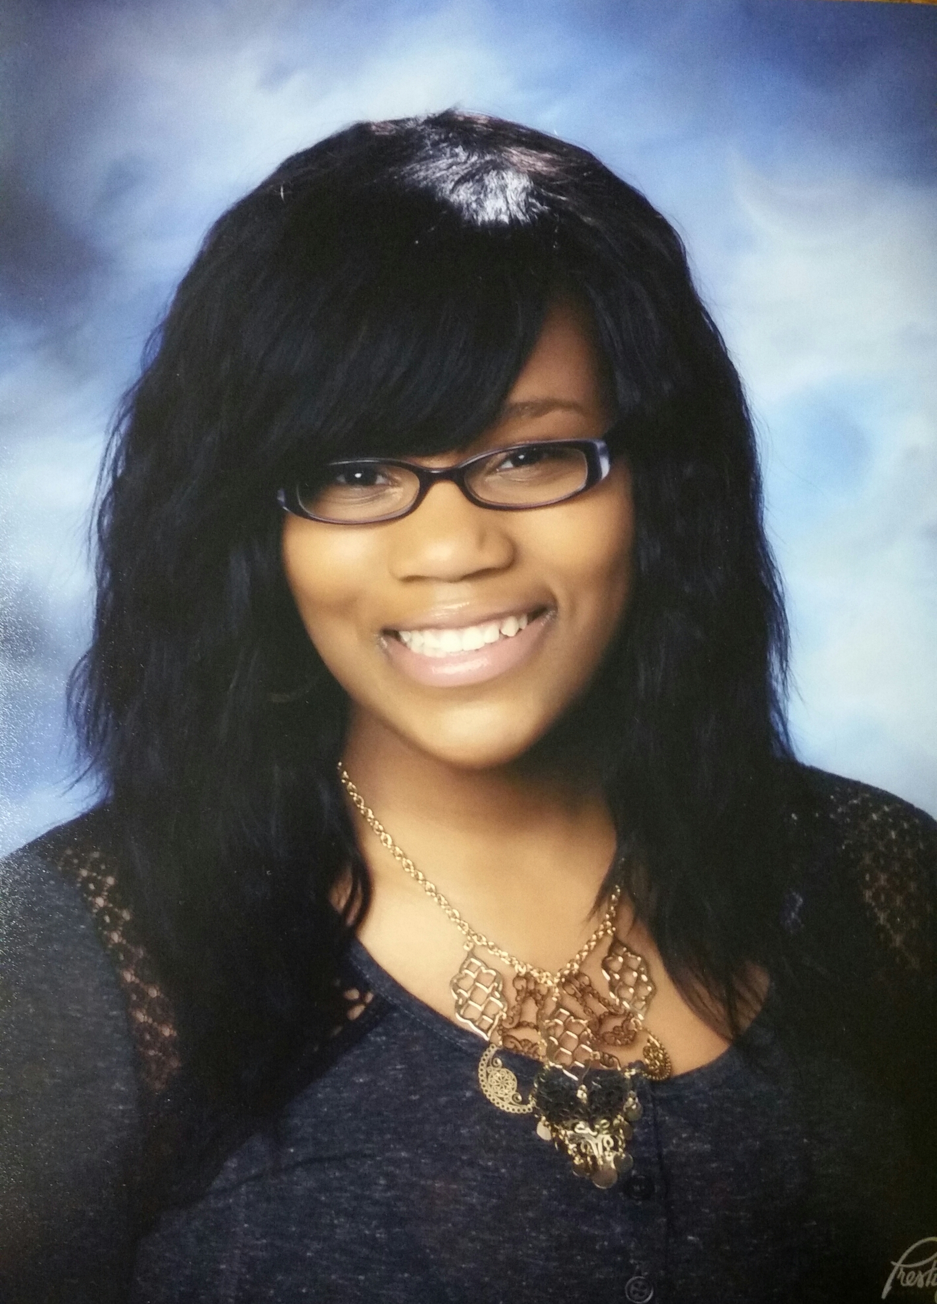
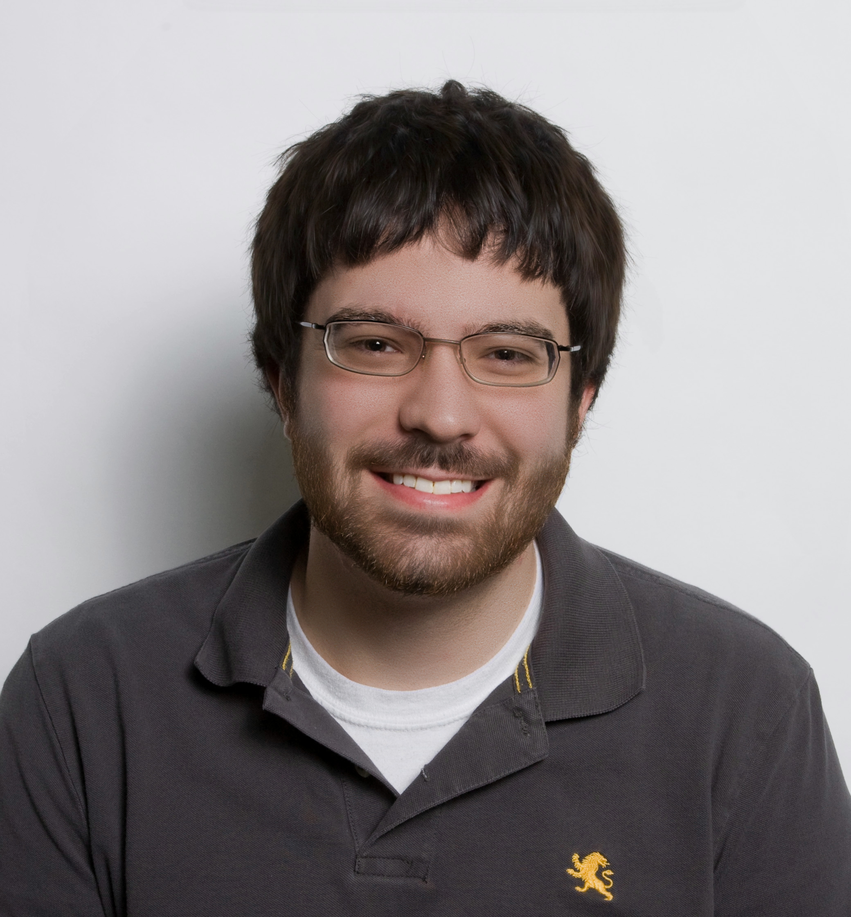
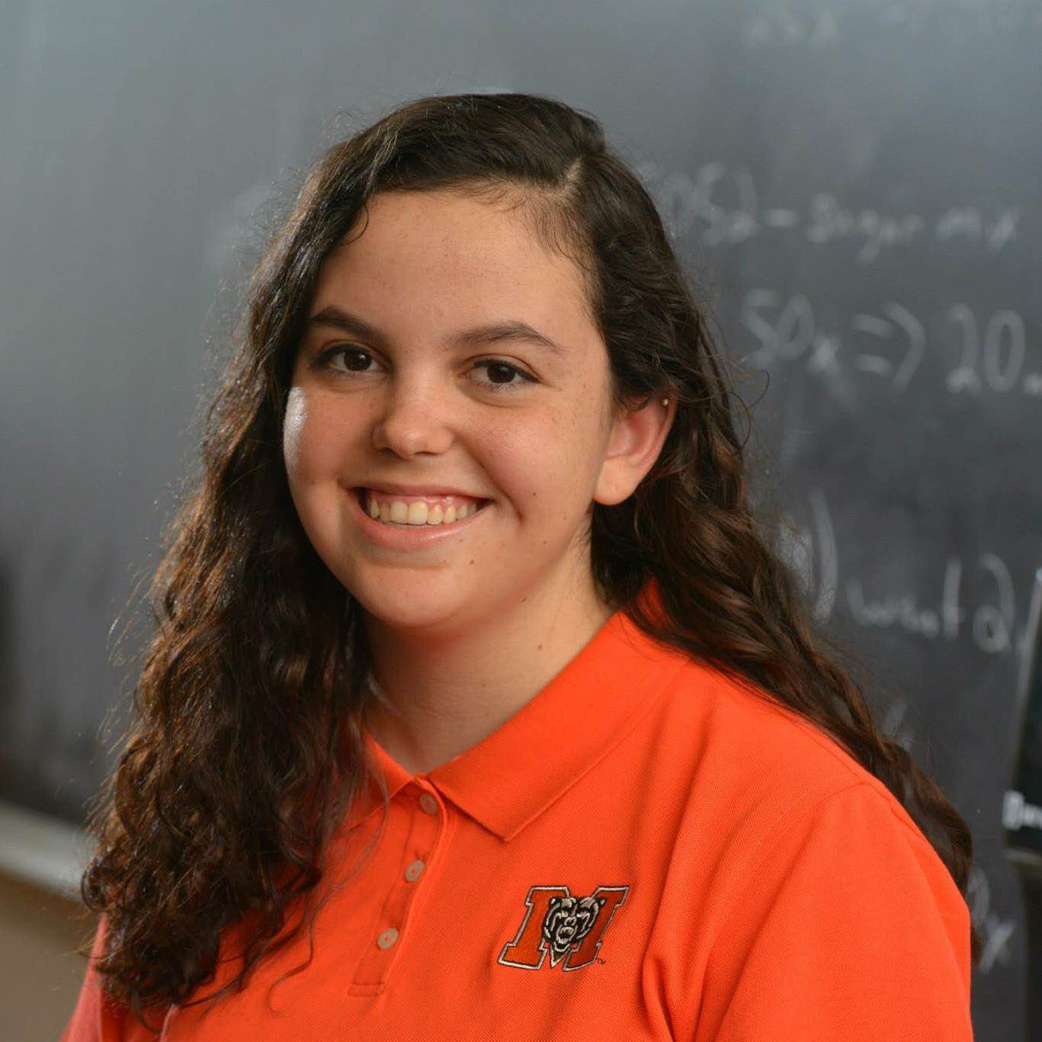
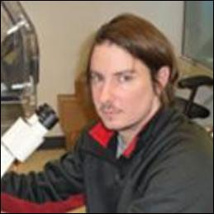


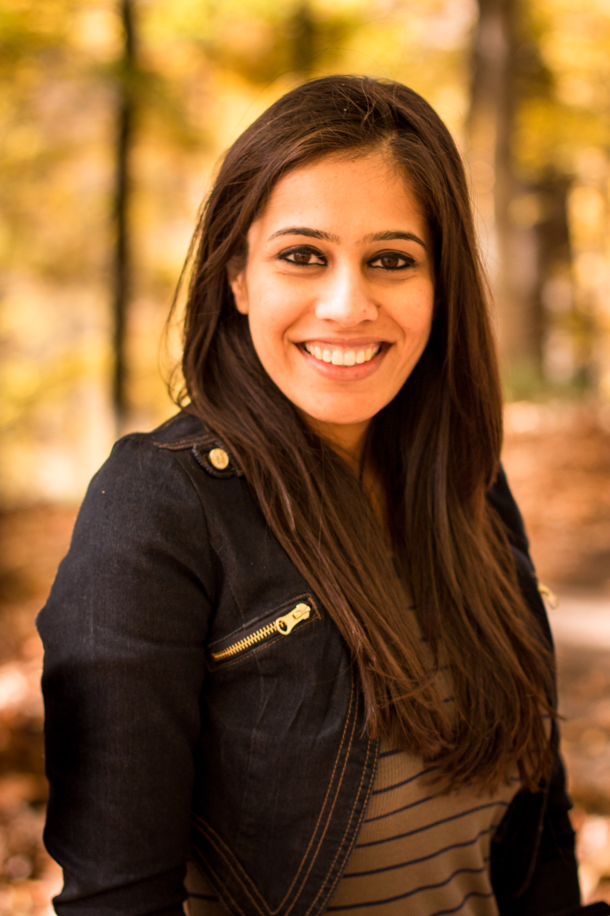
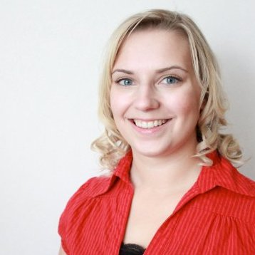
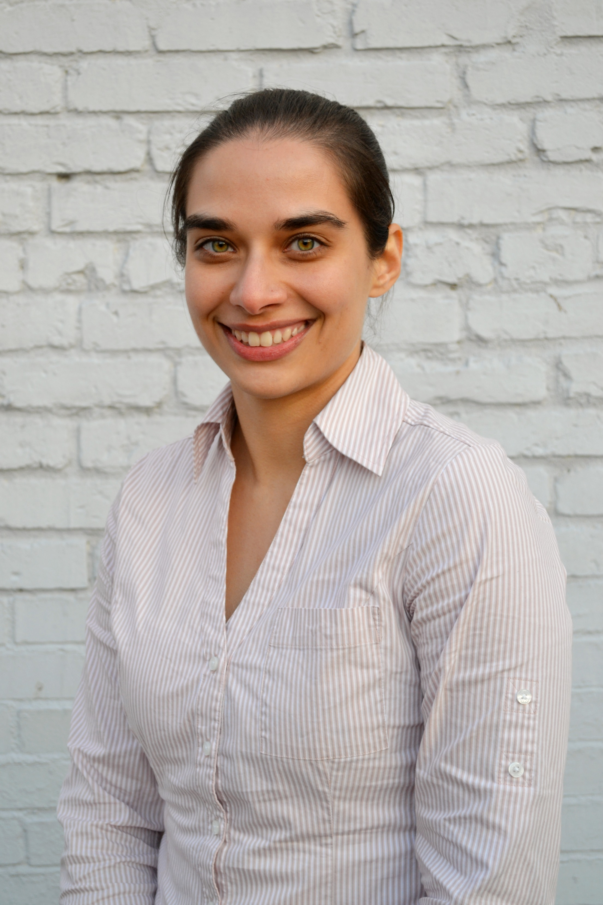
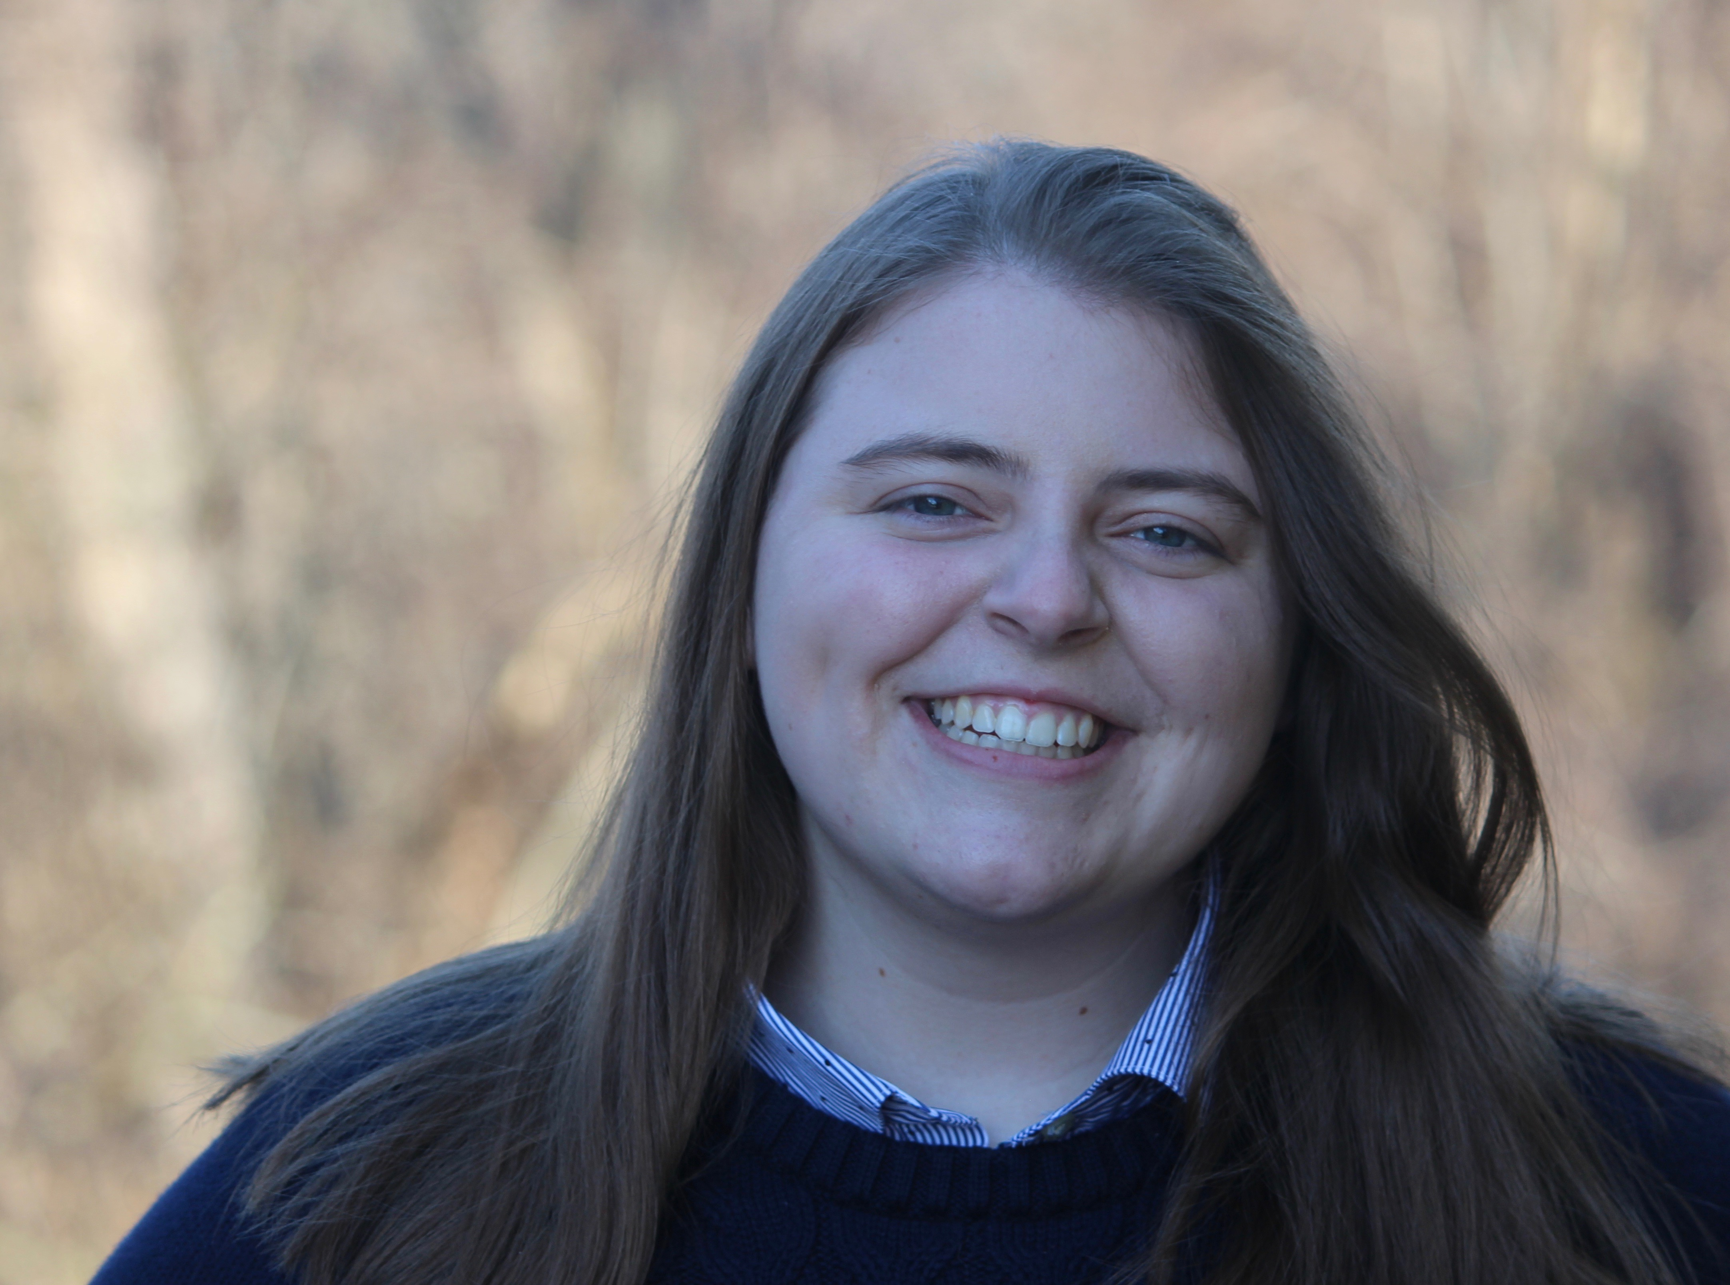

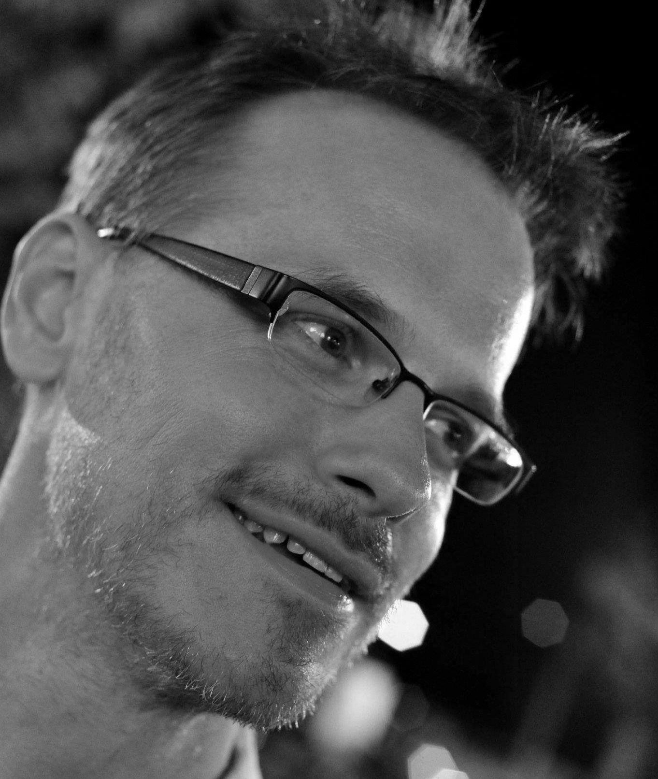
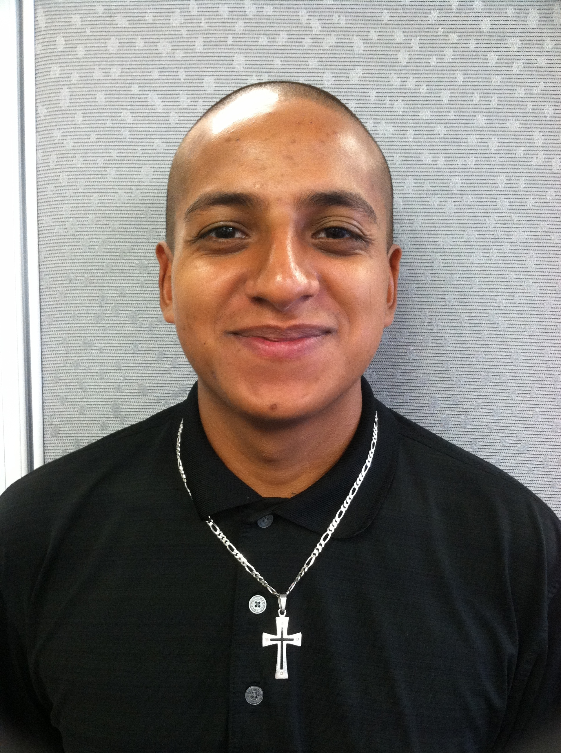
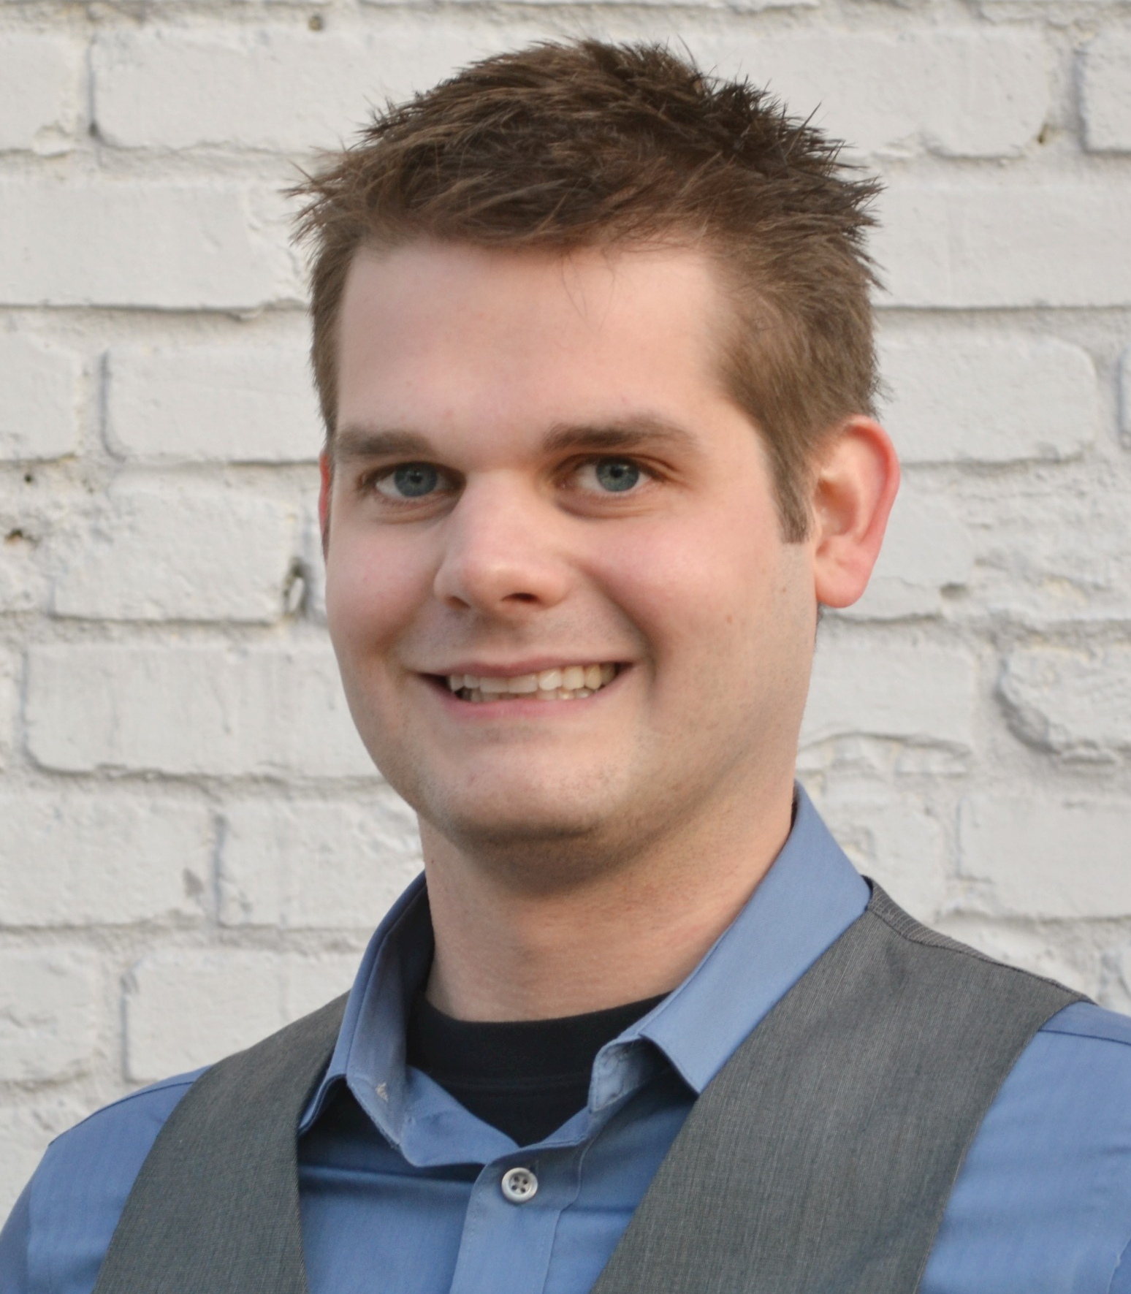
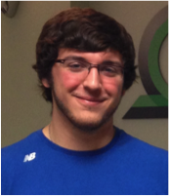
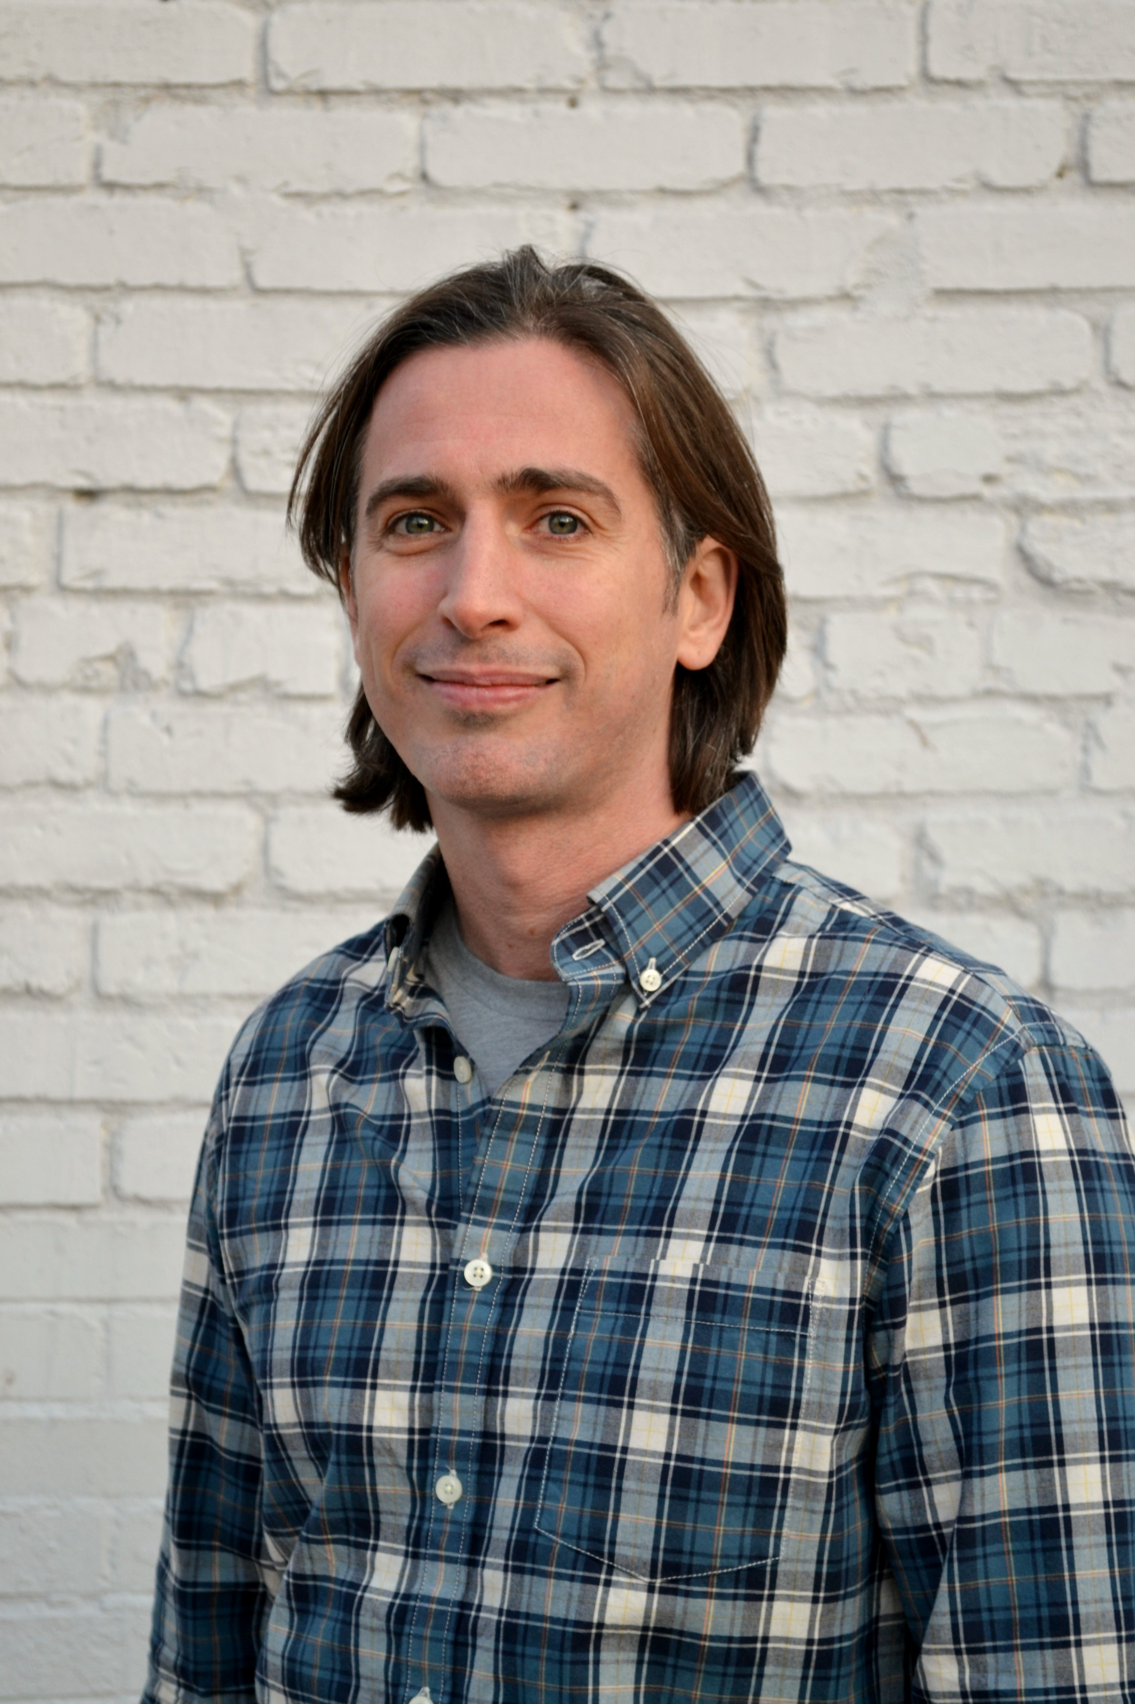
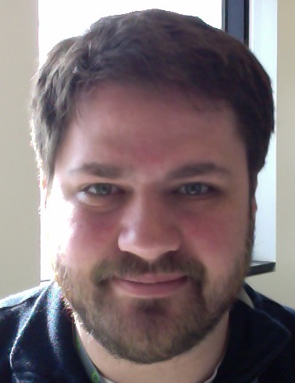
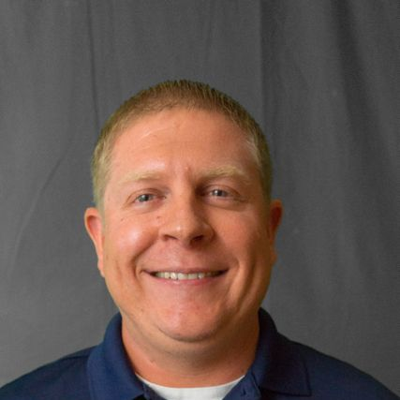
Acknowledgements: Griffith Lab group members
DoCM
CIViC
CIViC OSCC
OSCC
CIViC
CIViC/DGIdb
DGIdb/Regulome
Malachi
Griffith
Obi
Griffith
Benjamin
Ainscough
Erica Barnell
Katie
Campbell
Kaitlin Clark
Adam
Coffman
Kelsy Cotto
CIViC/Regulome
Regtools/pVAC-seq
pVAC-seq
pVAC-seq/CIViC
CIViC/Lymphoma
CIViC
HCC
Lymphoma
Arpad Danos
Yang-Yang Feng
Felicia Gomez
Jasreet
Hundal
Susanna Kiwala
Kilanin
Krysiak
Lynzey Kujan
Jason Kunisaki
CIViC
CIViC Lymphoma
genVisR
HCC/SCLC
CIViC/Komen
HCC/SCLC
DGIdb
SCLC
Director Informatics
Josh
McMichael
Cody Ramirez
Zachary
Skidmore
Nick
Spies
Lee
Trani
Alex
Wagner
Jason Walker
Notes:
Not shown: Lynzey Kujan (Intern), Susanna Kiwala,

Slide 41
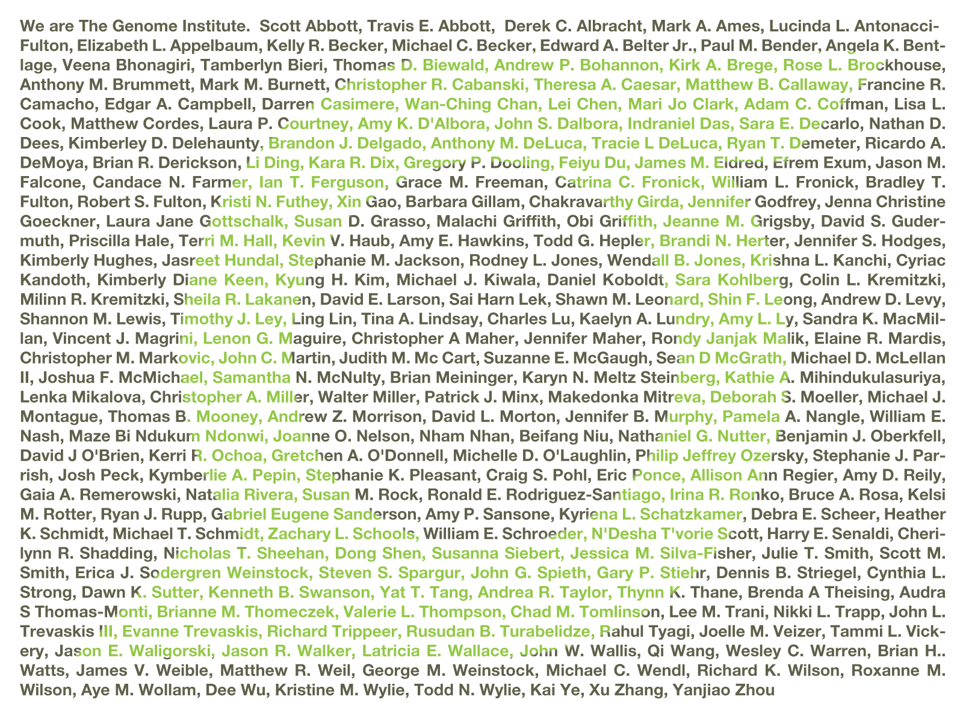
Acknowledgements: McDonnell Genome Institute
McDonnell Genome Institute @ Washington University School of Medicine
Susan Dutcher
Tim Ley
Bob Fulton
Lucinda Fulton
Ira Hall
Dave Larson
Chris Maher
Lukas Wartman
Matt Callaway
Chris Miller
Jason Walker

Slide 42
Introduction to GenViz course site
www.genviz.org

